Slide 1
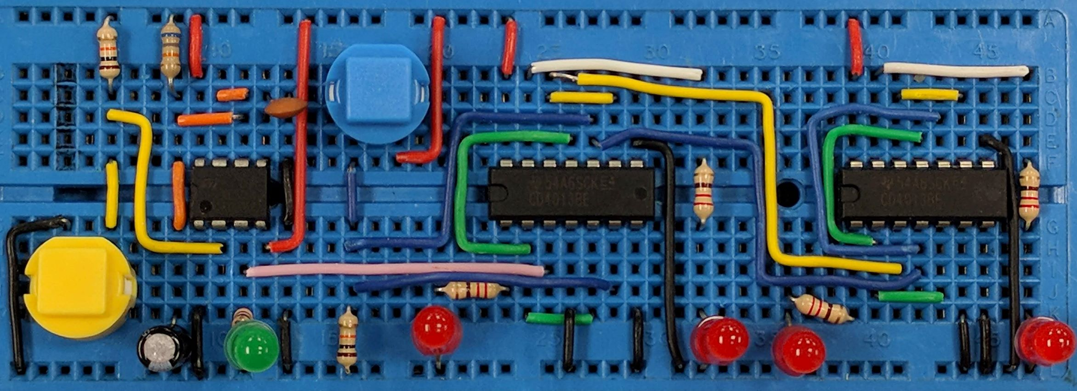
Bipolar Transistors
AIM:
To understand how bipolar transistor can be used as transducer drivers (including calculations)
PRIOR KNOWLEDGE:
Output transducers, current in circuits, calculating resistor values, calculating power, silicon diodes
www.pfnicholls.com

Slide 2
Bipolar Transistor Basics
A bipolar transistor has 3 leads called the BASE, COLLECTOR and EMITTER.
A bipolar transistor behaves as a switch.
A small current from a logic gate or other circuit can be used to control a more powerful output transducer.
The device should be called an “npn bipolar transistor” to be completely correct.
Current flows into the COLLECTOR
COLLECTOR
BASE
EMITTER
(The One with the arrow)
Current comes out of the EMITTER

Slide 3
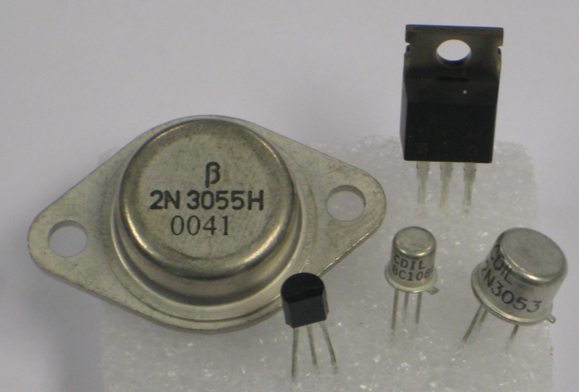
Bipolar Transistor Basics (2)
Some common bipolar transistors used are:
BC107 (low power)
BC441, BFY51, 2N3053
TIP31 (plastic package)
NOTE: The collector is usually attached to the metal case or the metal heatsink so take care. The emitter is identified by a tag on metal can style cases. Always check the datasheet.

Slide 4
Bipolar Transistor Basics (3)
When there is no current in the BASE, no current can flow from the COLLECTOR to the EMITTER
Large COLLECTOR current (I_{C})
Small BASE current (I_{B})
When a small current (I_{B}) flows in the BASE, a much larger current (I_{C}) can flow from COLLECTOR to EMITTER
When a the transistor conducts and a current flows into the BASE, the voltage across the BASE-EMITTER junction is 0.7 V
0.7 V

Slide 5
Using Bipolar Transistors
When used as a transducer driver:
The EMITTER is connected to 0 V
The COLLECTOR is connected to the transducer
The BASE is connected to whatever is controlling the transistor
A BASE resistor is necessary to limit the current into the BASE.
12 V
12 v bulb being controlled by the transistor
Small current in BASE turns on the transistor
R_{B}
BASE Resistor
0 V

Slide 6
Using Bipolar Transistors (2)
When used as a transducer driver with electric motors, relays or any device containing a coil a protection diode must be used
When the motor turns OFF a large backwards voltage is produced. Called “back EMF”
The back EMF can destroy the transistor
The diode limits the back EMF to 0.7 V which is a safe voltage and so protects the transistor
12 V
Diode in reverse Bias
M
0 V

Slide 7
Calculating the Gain
The current gain of a transistor is an number that tells us how big the COLLECTOR current is compared to the BASE current.
The symbol for current gain is h_{FE}
The equation for current gain is h_{FE} = I_{C} / I_{B}
The current gain depends on the type of transistor used
Example:
For the transistor shown, current gain = 200, what base current is required?
Solution:
Calculate the COLLECTOR current using the information given about the bulb
P = V I so I = P / V
I_{C} = 20 / 12 = 1.67 A
Calculate the BASE Current knowing the gain equation
h_{FE} = I_{C} / I_{B}
200 = 1.67 / I_{B}
I_{B} = 0.0083 A = 8.3 mA
12 V
20 W
R_{B}
0 V

Slide 8
Calculating the base resistor
To calculate the base resistor we need to know the current flowing into the base and the voltage across the resistor.
Use R = V / I
Example: A logic gate gives a voltage of 5 V which is used to turn on the transistor in the previous example.
What size of base resistor is needed?
12 V
Solution:
The transistor is conducting so BASE-EMITTER voltage = 0.7 V
Calculate the voltage across the BASE resistor
V_{B} = 5.0 – 0.7 = 4.3 V
20 W
0.7 V
Calculate R_{B}
R_{B} = 4.3 / 0.0083
R_{B} = 516 Ω
Use lower value from those available
R_{B} = 470 Ω
5 V
4.3 V
Voltage from previous circuit = 5 V
R_{B}
I_{B} = 8.3 mA
0 V

Slide 9
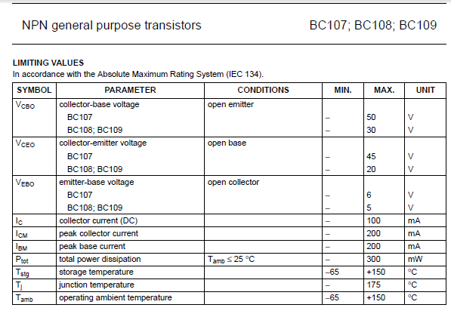
Using Datasheets
Datasheets, such as the one shown below, are available online but they contain A LOT of information.
Look for the main features:
Maximum Collector to Emitter voltage when not turned on
Max collector current – an important value
Max power before you need a new one

Slide 10
Bipolar transistors vs MOSFETs
MOSFET | BIPOLAR TRANSISTOR
MOSFETs require a VOLTAGE at the GATE to allow them to conduct | Bipolar transistors require a CURRENT flowing into the BASE to allow them to conduct
No current flows into the GATE MOSFETs have a very high input resistance | Current flows into the BASE The base resistance is not very high
Very easy to use – no calculations required | Need a base resistor. Calculations of base resistor and gain are needed to ensure correct operation
Require about 3 V to turn them on Cannot be used with low voltage battery operated circuits | Need 0.7 V to turn them on and so can be used with low voltage battery operated circuits
Easily damaged by static | Quite robust and not easily damaged

Slide 11
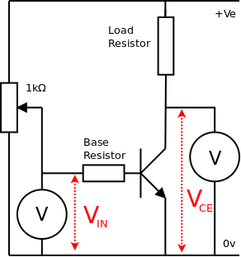
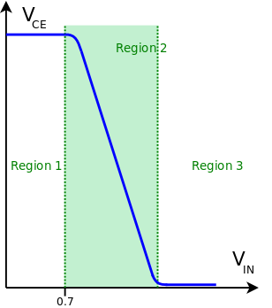
V_{IN} vs V_{OUT}
V_{IN} is the voltage applied to the base resistor
V_{OUT} is measured between the Collector and Emitter
V_{OUT} is also called V_{CE}
Region 1: V_{IN} is less than 0.7 V. The transistor is off. No current flows through the load resistor. The potential difference across the load resistor is zero (V = IR and I = 0). The voltage at the collector is the same as the supply voltage. V_{CE} = V_{supply}
When V_{IN} is LOW, V_{OUT} is HIGH

Slide 12
V_{IN} vs V_{OUT}
The circuit shows how V_{IN} can be varied using a potentiometer
Voltmeters are used to measure V_{IN} and V_{CE}
Region 2: V_{IN} is greater than 0.7 V. Current flows through the Base resistor. Current flows through the load resistor into the Collector. There is a potential difference across the load resistor (V = IR and I ≠ 0)
V_{CE} = V_{supply} – V_{load}
Current flows through the transistor. There is a voltage between the Collector and Emitter. The transistor dissipates energy – it gets hot

Slide 13
V_{IN} vs V_{OUT}
When used as a transducer driver the transistor should operate in region 3 with enough base current to ensure V_{CE} = 0
Region 3: V_{IN} is greater than 0.7 V. Enough current flows through the Base resistor to allow enough current to flow through the load resistor to make the potential difference equal to the supply voltage. V_{load} = V_{supply} and V_{CE} = 0
No (or minimal) power is dissipated. The transistor is saturated and current is only limited by the load resistor

Slide 14
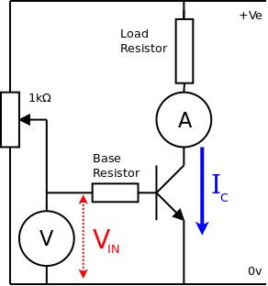
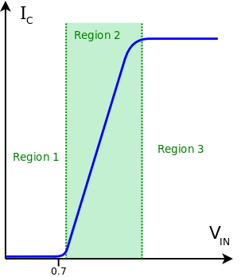
V_{IN} vs I_{C}
V_{IN} is the voltage applied to the Base resistor
I_{C} is the current flowing through the load resistor and into the Collector
Region 1: V_{IN} is less than 0.7 V. There is no potential difference across the Base resistor. No current flows into the Base
The transistor is OFF and does not conduct
No current flows through the transistor. I_{C} = 0

Slide 15
V_{IN} vs I_{C}
The circuit shows how V_{IN} is varied with a potentiometer
A voltmeter measures V_{IN} and an ammeter measures I_{C}
Region 2: V_{IN} is greater than 0.7 V. VBE = 0.7 V. There is a potential difference across the Base resistor. Current flows into the Base and therefore current flows into the Collector. IC ≠ 0
As V_{IN} increases, the potential difference across the Base resistor increases. The current flowing into the Base increases and therefore the Collector current increases. V_{IN}↑ ∴ I_{C}↑

Slide 16
V_{IN} vs I_{C}
When used as a transducer driver the Base current should be great enough to allow the transistor to operate in region 3
Region 3: V_{IN} is greater than 0.7 V. The transistor is saturated
V_{CE} = 0 and the current is only limited by the load resistor. The load resistor is fixed and so I_{C} has reached a maximum value
V_{IN} increases but I_{C} does not change

Slide 17
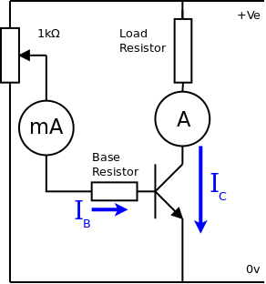
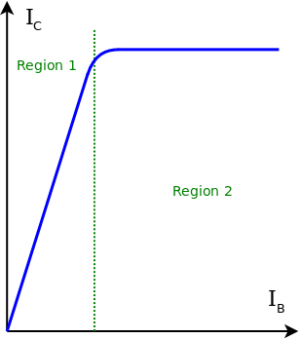
I_{B} vs I_{C}
I_{B} is the current flowing into the Base
I_{C} is the current flowing into the Collector
Region 1: The Collector current increases as the Base current increases. The relationship is linear
I_{C} is directly proportional to I_{B}
I_{C} = h_{FE} x I_{B}

Slide 18
I_{B} vs I_{C}
The circuit shows how ammeters can be used to measure I_{B} and I_{C}
Region 2: The transistor is saturated and the current is limited by the load resistor
I_{B} increases but I_{C} remains constant

Slide 19
Summary
NPN Bipolar transistors have a BASE, COLLECTOR and EMITTER and can be used as a switch. They need a BASE resistor to limit the current flowing into the BASE.
When BASE-EMITTER voltage = 0.7 V and current flows into the BASE then a large current can flow from COLLECTOR to EMITTER
The Gain equation is h_{FE} = I_{C} / I_{B} and h_{FE} is typically ≈ 100 but this value depends on the transistor being used
Protection diodes must be used when switching loads with a coil such as motors, heaters and relays
Maximum ratings of current, voltage and power must be researched using online datasheets and these values are different for each transistor
Transistors can get hot if they dissipate too much power and so a heatsink might be necessary where high power output transducers are used

Slide 20
Questions
An npn bipolar transistor has a collector current of 5 A and needs a base current of 400 mA. What is the gain of the transistor?
An npn transistor needs a base current of 20 mA and the base resistor is attached to a 9 V battery. What value of base resistor should be used?
An npn bipolar transistor is used to switch on a load when it receives a signal from a control circuit. The transistor has a current gain of 200. If the output from the control circuit is 12 V and the current required by the load is 400 mA, what value of base resistor is needed?

Slide 21
Answers
h_{FE} = I_{C} / I_{B} I_{C} = 5 A and I_{B} = 0.4 A (note change of units)
h_{FE} = 5 / 0.4 = 12.5 (there are no units)
When transistor conducts, the BASE voltage is 0.7 V
The voltage across resistor = 9 V – 0.7 V = 8.3 V
BASE current = 20 mA so R = 8.3 / 0.02 = 415 Ω so use 390 Ω
The gain equation gives a BASE current of 400 mA / 200 = 2 mA
BASE voltage of 0.7 V means that there is a voltage across the BASE resistor of 12 V – 0.7 V = 11.3 V
Therefore, R = 11.3 / 0.002 = 5650 Ω so use 5600 Ω

