Slide 1
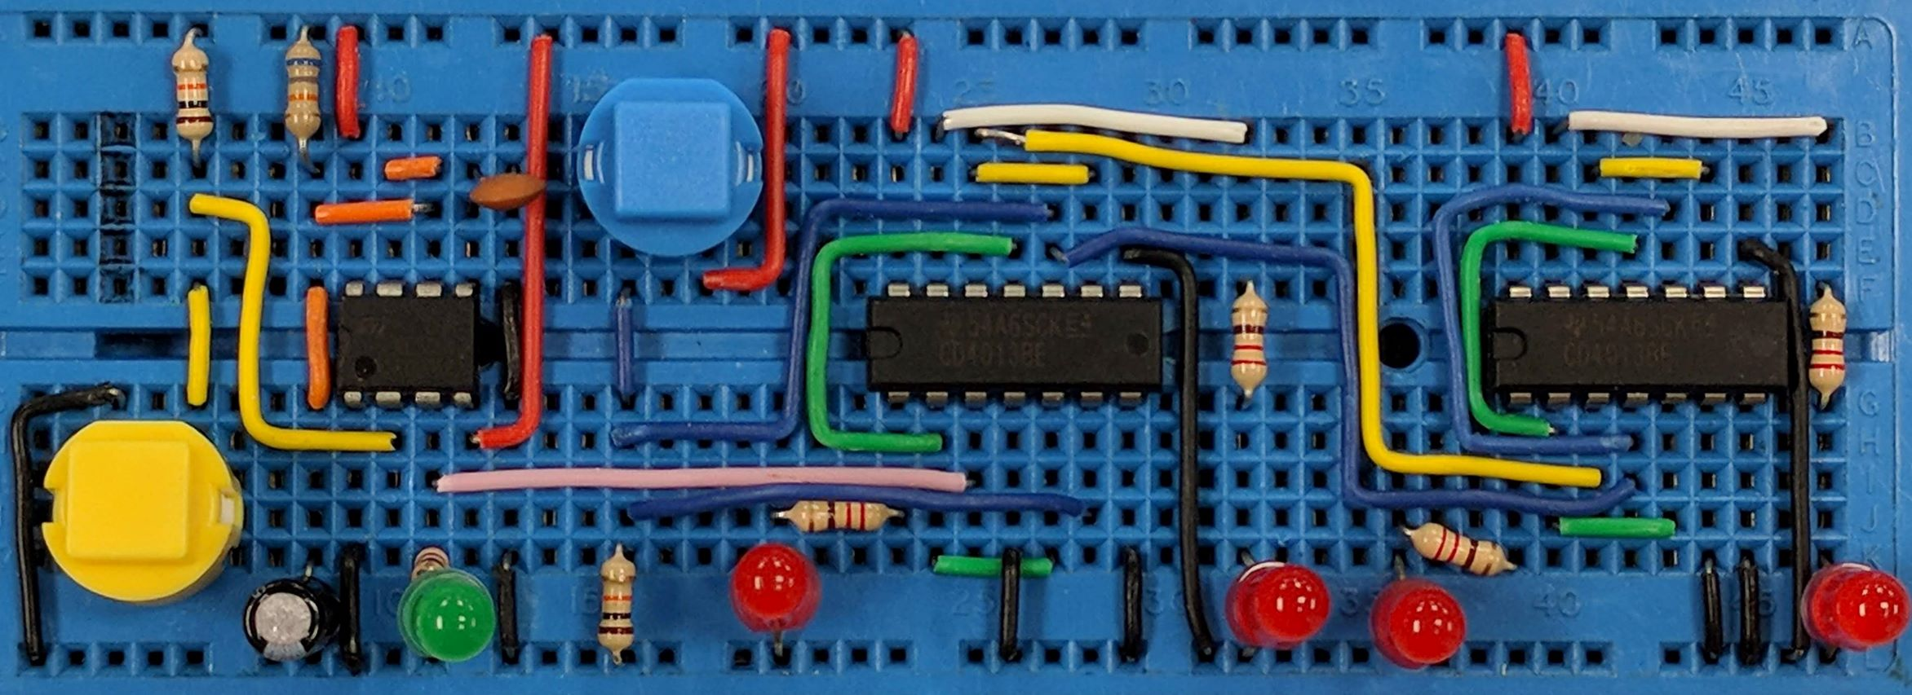
Diodes
AIM:
To understand diode characteristics
To appreciate what diodes are used for
PRIOR KNOWLEDGE:
Simple circuit rules, using resistors
www.pfnicholls.com

Slide 2
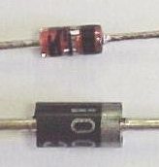
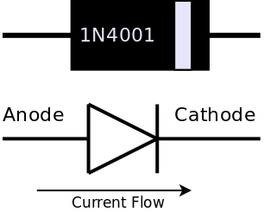
Diode Basics
A diode only allows current to flow in one direction.
Circuit Symbol for a Diode
The Cathode is marked with a band
A diode has two terminals called the Anode and Cathode.
Current only flows from the Anode to the Cathode
Two different types of diode.
The top one is a signal diode that can only handle small currents
The 1N4001 Diode shown can handle currents up to 1 Amp, other diodes can handle even more current

Slide 3
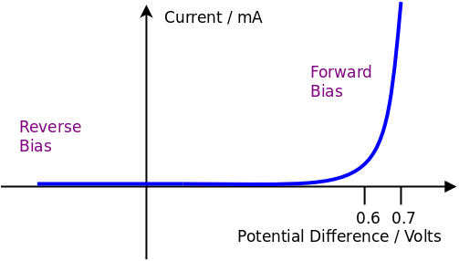
Basic Operation
The graph shows how the current through a diode depends on the potential difference across the diode
In Reverse Bias the diode is backwards and no current flows through the diode
When the potential difference across the diode is less than 0.6 V no current flows
When the potential difference is greater than 0.6 V the diode
conducts and current flows
As the current increases, the potential difference stays almost constant at about 0.7 V

Slide 4
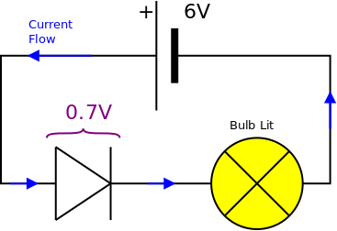
Forward Bias
When a diode is connected so that current can flow it is said to be FORWARD BIASED
In the example shown:
The battery voltage is 6 V which is enough to make the diode conduct
The forward voltage drop across the diode is 0.7 V
The potential difference across the bulb is therefore 5.3 V
The diode will be damaged if too much current flows

Slide 5
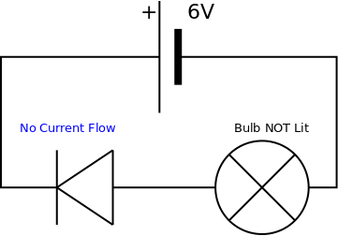
Reverse Bias
When a diode is connected so that NO current can flow it is said to be REVERSE BIASED
In the example shown:
The battery voltage is 6 V but the diode is connected “backwards”
The reverse bias voltage drop across the diode is 6 V
The potential difference across the bulb is therefore zero – the bulb is not lit
The diode will be damaged if the reverse bias voltage is too great

Slide 6
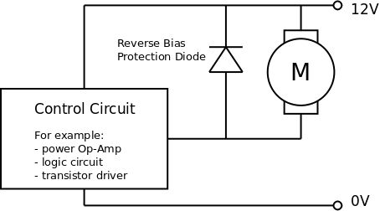
Protection Diode
Physics fact: When current suddenly stops flowing through a coil (called an inductive load) such as a motor, solenoid or relay then a large voltage is generated – this is called the “back EMF”.
Electronics fact: The back EMF will easily damage transistors and integrated circuits that are controlling the inductive load.
Solution: Add a diode in reverse bias across the inductive load (the motor in the diagram)
Note: The diode protects the control circuit, not the motor

Slide 7
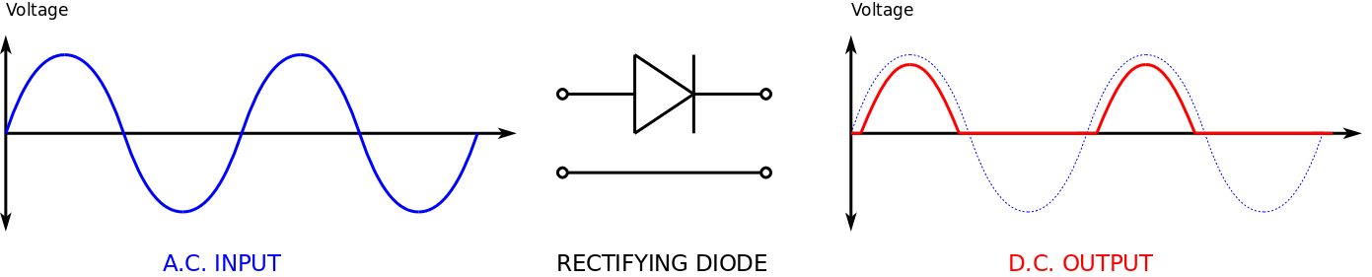
Rectification
A.C. – Current flows alternately in each direction
D.C. – Current only flows in one direction
Because a diode only allows current to flow in one direction it can be used to convert A.C. into D.C.
This process is called RECTIFICATION
Note the peak voltage is 0.7 V less than the input

Slide 8
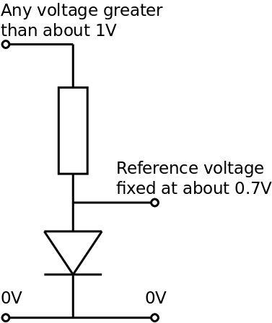
Voltage Reference
The input voltage can be any reasonable voltage as long as it is above 0.7 V so that the diode conducts
When a reasonable current flows through a diode, the potential difference across the diode is approximately constant at about 0.7 V
A diode in a potential divider can provide a relatively constant reference voltage even when the supply voltage changes which is useful in comparator circuits.
The output voltage will vary a bit but be about 0.7 V

Slide 9
Summary
Diodes only allow current to flow in one direction
Current can flow when the diode is forward biased
Current does not flow when the diode is reverse biased
When the diode is conducting and current is flowing, the potential difference across the diode is approximately 0.7V
Too much (forward biased) current will damage the diode
Too much (reverse biased) voltage will damage the diode
Diodes can protect semiconductor devices from the back emf produced by inductive loads
Diodes can be used to rectify A.C. signals
Diodes in a potential divider can provide a fixed reference voltage

Slide 10
Questions
What is the potential difference across a diode when it is conducting?
How can a diode be damaged?
What does rectification mean?
How can you tell which way round to put a diode in your circuit?
What does forward bias mean?
Why is a protection diode connected so that it is reverse biased?

Slide 11
Answers
The voltage across a diode when it is conducting is 0.7 volts
A diode is damaged by too much forward current OR too much reverse voltage
Rectification means converting A.C. into D.C
You can work out which way round to put a diode in your circuit because the cathode is marked with a band
Forward bias means connected so that current can flow i.e. with the anode connected to the positive side of the battery
A protection diode is connected reverse biased so that it does not usually conduct and is therefore not part of the circuit

