Slide 1
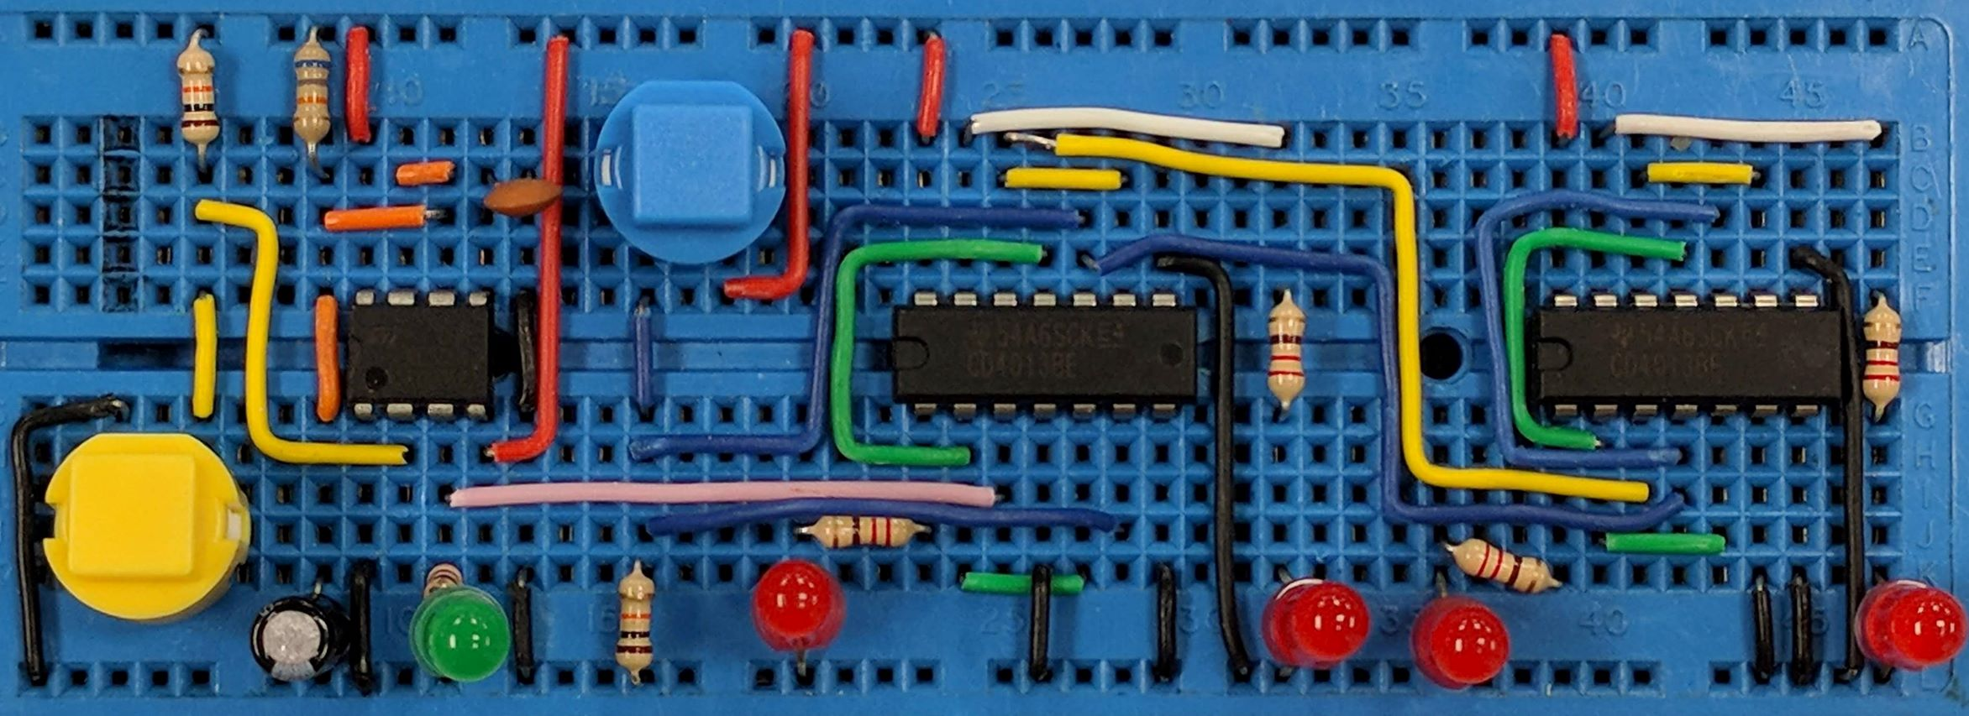
LDRs & Thermistors
AIM:
To understand the properties of LDRs and Thermistors
PRIOR KNOWLEDGE:
Know about resistance
www.pfnicholls.com

Slide 2
LDR Behaviour
A Light Dependant Resistor (LDR) is a type of resistor. The resistance changes as the light level changes.
When the light is brighter, the resistance is lower.
When there is less light, the resistance increases.
The typical resistance of an LDR is a few thousand ohms.
In very bright light the resistance may fall to just a few hundred ohms and a current limiting resistor is needed to prevent the LDR being damaged by excessively large currents.
In total darkness the resistance may be several Mega-ohms

Slide 3
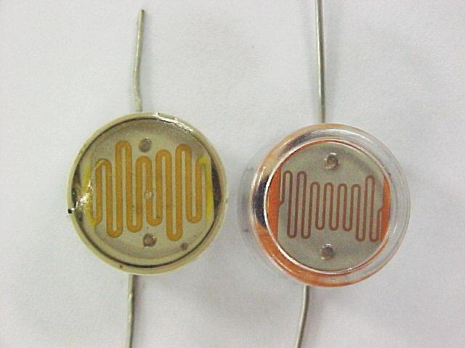
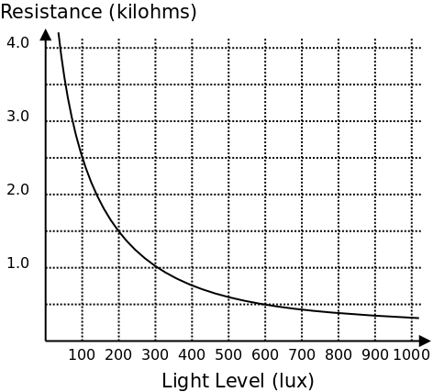
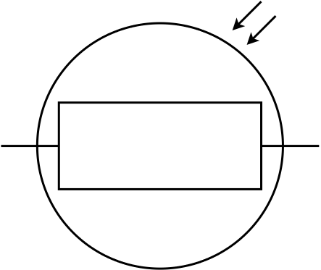
LDR Behaviour
Typical values

Slide 4
NTC Thermistor Behaviour
A Negative Temperature Coefficient (NTC) Thermistor is a type of resistor. The resistance changes as the temperature changes.
When the temperature is higher, the resistance is lower.
When the temperature is lower, the resistance increases.
At room temperature, the resistance of a thermistor is thousands of ohms. At higher temperatures the resistance decreases to a few hundred ohms. As the current increases it heats up the thermistor leading to a lower resistance leading to more current and more heating and so on. The cycle repeats and this is called thermal runaway and can destroy the thermistor.

Slide 5
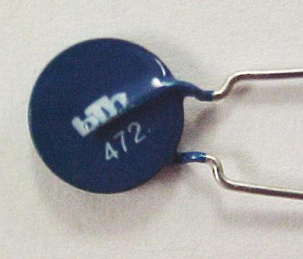
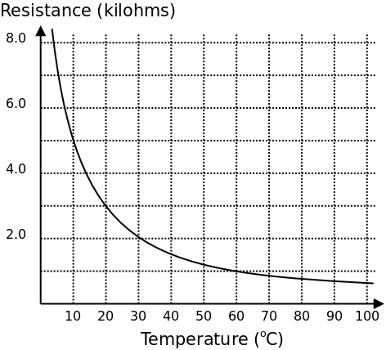
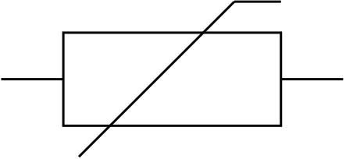
Thermistor Behaviour

Slide 6
Applications & Limitations
LDRs and Thermistors are known as input transducers because they convert information about the environment into electrical information.
They can be used to create electrical signals (voltages or currents) that respond to changes in the environment.
They are not much use on their own. A circuit such as a potential divider is needed to convert their change in resistance into a change of voltage or current.
Thermistors are not so good at measuring high temperatures because their resistance changes less significantly at high temperatures. Small changes in temperature are not detected so well. The same applies to LDRs in bright light.

Slide 7
Theory
Metals are good conductors because all of the valance electrons (outer shell electrons) are free to conduct electricity.
A Thermistor is a semi-conductor, usually based on Silicon. In a semi-conductor, not all of the valance electrons are free to conduct, some are bound to their atoms and cannot move freely around the lattice.
As the temperature increases, the electrons gain more energy. Some gain enough energy to become free from their atoms. As the temperature increases the number of free electrons increases so the current increases and therefore the resistance has decreased.
The same theory applies for LDRs where the extra energy is light.

Slide 8
Summary
The resistance of an LDR increases as the light level falls
The resistance of an LDR decreases as the light gets brighter
The resistance of a thermistor increases as the temperature falls
The resistance of a thermistor decreases at higher temperatures
The typical resistance of LDRs and Thermistors is thousands of ohms. Series resistors must be used to prevent damage due to high currents in bright light or at high temperatures
The resistance of an LDR or thermistor changes less dramatically in bright light or at high temperatures and so they become less sensitive to small changes

Slide 9
Questions
For the LDR graph (slide 3) what is the resistance at 400 lux?
What light level gives a resistance of 3kΩ
What is the change in resistance between 100 lux and 200 lux? What is the change in resistance between 900 lux and 1000 lux? Why is an LDR less useful as a sensor in bright light?
For the Thermistor (slide 5) what is the resistance at 30°C?
What temperature gives a resistance of 7kΩ?
Why will it be difficult to measure the temperature at 400°C using this thermistor?

Slide 10
Answers
Approximately 750 Ω
About 70 Lux
From the graph:
A. 2k5 to 1k5, a change of 1 kΩ,
600 Ω to 400 Ω, a change of 200 Ω
The change of resistance is smaller in bright light so the LDR is less effective as a light detector … It doesn’t respond well to small changes in light level
2 kΩ
5 ⁰C
Because the resistance hardly changes beyond 100 ⁰C

