Slide 1
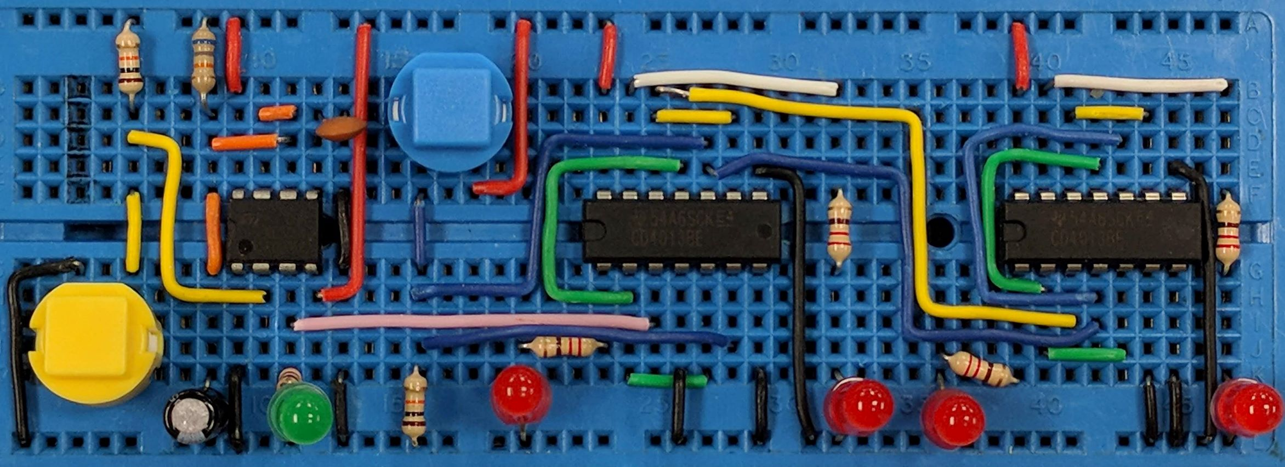
Logic Circuits Analysis
AIM:
To be able to analyse logic circuits to complete a truth table that describes what the logic circuit does
PRIOR KNOWLEDGE:
Logic gate truth tables for AND, OR and NOT gates
www.pfnicholls.com

Slide 2
Introduction
A logic circuit – a circuit made from logic gates – can be analysed and described using a truth table
For non-trivial circuits, extra columns need to be added to the truth table for the points in the circuit between the inputs and the output
Work through the logic circuit completing one column at a time

Slide 3
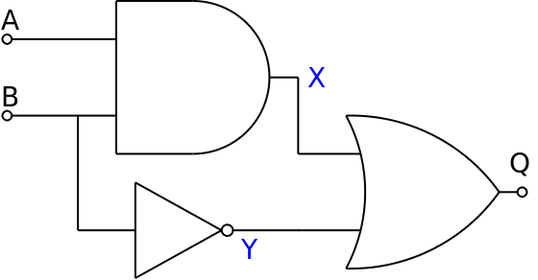
Logic Circuit Analysis
1. Complete columns A and B in the truth table (always in the same order)
X
2. Add point X on the diagram after the AND gate and add this to the truth table
Y
3. Add point Y on the diagram after the NOT gate and add this to the truth table
A | B
0 | 0
0 | 1
1 | 0
1 | 1
X
0
0
0
1
Y
1
0
1
0
Q
1
0
1
1
4. Using X and Y as the inputs to the OR gate, complete the final column for output Q

Slide 4
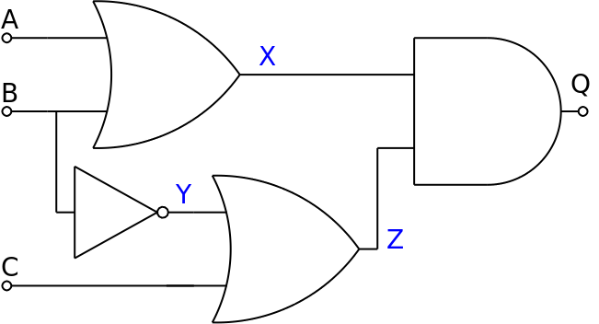
3 input Logic Circuit Analysis
1. Complete the truth table for inputs A, B and C
2. Complete the column for X using A and B as the inputs to the OR gate
3. Complete the column for Y using B as the input to the NOT gate
A | B | C
0 | 0 | 0
0 | 0 | 1
0 | 1 | 0
0 | 1 | 1
1 | 0 | 0
1 | 0 | 1
1 | 1 | 0
1 | 1 | 1
X
0
0
1
1
1
1
1
1
Y
1
1
0
0
1
1
0
0
Z
1
1
0
1
1
1
0
1
Q
0
0
0
1
1
1
0
1
4. Complete the column for Z using Y and C as the inputs to the OR gate
5. Complete the column for Q using X and Z as the inputs to the AND gate

Slide 5
Summary
Know the truth tables for all the logic gates
Complete the columns for the input in the right order
Add an extra column for the output of each logic gate
Complete the extra columns one at a time
The final output is completed using the extra columns
Extra columns are usually shown in grey or shaded
Once the truth table is complete the extra columns can be ignored and only the inputs (A, B, C etc) and the output (Q) need to be considered

Slide 6
Questions
Why should the inputs always be written in the same order?
Why are extra columns used?
Why are extra columns in grey or shaded?
How many extra columns are needed?

Slide 7
Answers
You are less likely to make a mistake and more likely to include all the different combinations
You are less likely to get confused and make a mistake and other people can follow your reasoning more clearly
Extra columns are temporary, they are not part of the final truth table, just steps along the way
One for each logic gate output before the final output

