Slide 1
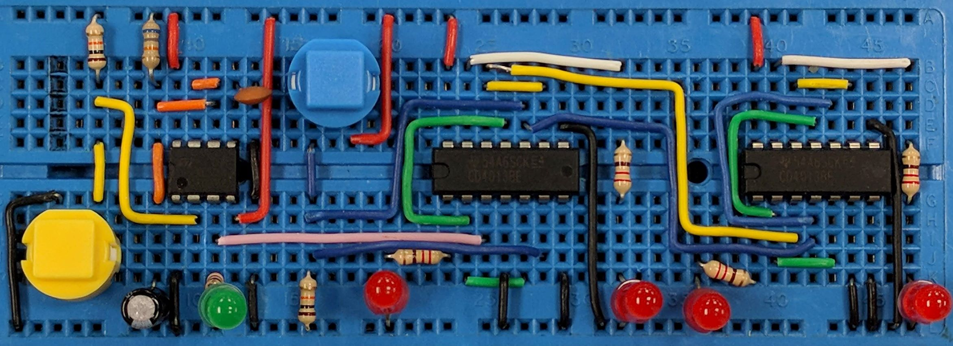
Logic - Introduction
AIM: To understand the difference between analogue and digital electronics, combinational and synchronous logic circuits and the need for pull-up and pull-down resistors.
PRIOR KNOWLEDGE: Potential dividers
www.pfnicholls.com

Slide 2
Overview
Logic circuits deal with digital signals or digital inputs and produce digital outputs.
They manipulate information that is in a digital format. This is useful because digital signals can be used to represent binary numbers and so logic circuits can manipulate binary mathematics - this makes them very powerful.
Many modern devices use digital electronics and logic circuits are fundamental to using digital electronics.

Slide 3
2 types of logic circuits
Combinational Logic Circuits
The output only depends on the inputs. If the inputs change, the output immediately changes too. Examples include:
Simple logic gates
Logic circuits containing multiple logic gates
Logic circuits with multiple inputs
Logic operators such as Full Adders, Half Adders and Multiplexers
Synchronous Logic Circuits
The output depends on the inputs and also what the inputs were previously. The output depends on the state of the inputs and how the inputs have changed some time before. Examples include:
Monostable circuits
Bistable circuits, latches and flip flops
Astable circuits
Counters
Shift registers

Slide 4
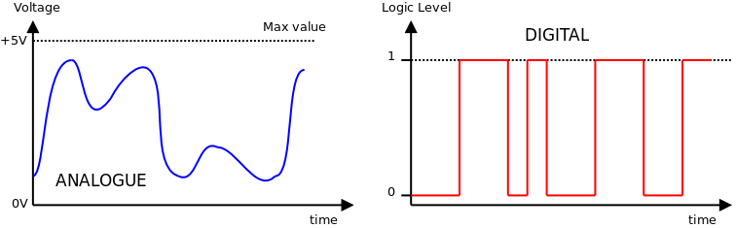
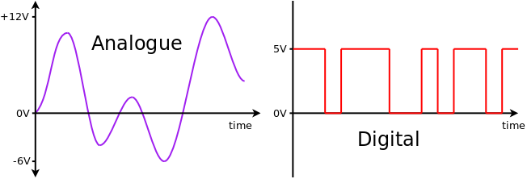
Analogue Signals
Logic circuits do NOT work with analogue signals
Analogue signals can have any value between two limits. An analogue signal could be between 0 V and 9 V when a circuit is run off a 9 V battery or between −15 V and +15 V in a circuit which is run off a ±15 V power supply. Analogue signals can be both positive and negative and take any value between the maximum and minimum values.

Slide 5
Digital Signals
Logic circuits work with digital signals
Digital signals have only two possible states - they are either ON or OFF. ON is called Logic 1. OFF is called Logic 0.
In electrical circuits these states are represented by voltages. Logic 1 is a high voltage and is usually understood to be +5 V.
Logic 0 is a low voltage and is usually understood to be 0 V.
Digital signals are either logic 0 or logic 1
The diagram shows a digital signal repeatedly changing between logic 0 and logic 1

Slide 6
Digital Signals part 2
If, for example, a circuit is power by a 9 V battery then Logic 1 might be anything above 6 V and Logic 0 might be anything below 3 V; the actual voltages depending on exactly what components are used.
The values of Logic 1 and Logic 0 are not absolutely defined.
The value in the middle - between 3 V and 6 V in this case - is undefined and is neither Logic 1 or Logic 0.
The diagram shows a digital signal where logic 0 is represented by 0 V and logic 1 is represented by 5 V
If a 9 V battery was used then logic 1 would be a value close to 9 V and logic 0 would be a value close to 0 V

Slide 7
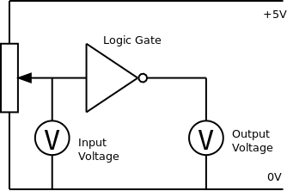
Testing Logic Circuits
When does logic 0 become logic 1?
At exactly what voltage a logic circuit decides that the input is no longer a '0' and is now a '1' depends on the circuit. To be safe we usually try and use a value close to zero volts for logic 0 and some voltage close to the supply voltage for logic 1.
For logic gates using a 5 V supply it is usually the case that anything below 2 V is a Logic 0 and anything above 3 V is a Logic 1 but it is always a good idea to check.
The circuit shown can be used to investigate the exact transition point of a logic gate. The potentiometer provides a variable input voltage and voltmeter measures the input voltage. A second voltmeter measures the output voltage.

Slide 8
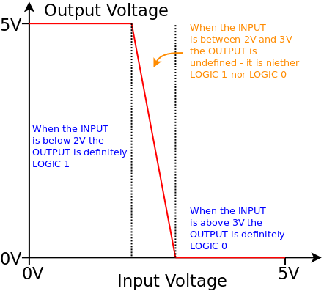
Transfer Characteristics
A graph of Input voltage against Output voltage is called the transfer characteristic of the logic gate - it shows how the input and output voltages are related.
The diagram shows a typical transfer characteristic for a Logic NOT gate but it should be noted that all logic gates have their own transfer characteristics and, if the exact values are needed, then the logic gate must be tested.

Slide 9
Inputs and Outputs
How do we provide an input to our logic circuit?
If the input to a logic circuit is derived from another logic circuit then there is no problem as it will always be either fully Logic 0 or fully Logic 1.
If we are using switches as our inputs then we must be careful not to leave any wires 'unconnected' (technically such an unconnected input is called 'floating’).
An input that is not connected to anything is not at Logic 1 or Logic 0, it is Logic whatever it wants to be ... and this will cause all sorts of problems and erratic behaviour.
Therefore, the rule is inputs should always be connected to something. Pull-up or pull-down resistors are used to ensure that the input to the logic circuit is always connected to something.

Slide 10
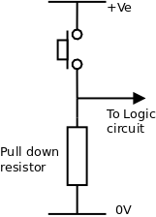
Pull-Down
When the push button is not pressed, the logic circuit is connected to 0 V through the resistor. The input to the logic circuit is Logic 0.
When the push button is pressed, the logic circuit is connected directly to the positive power supply. The input to the logic circuit is Logic 1.
The resistor is necessary so that, when the button is pressed, the positive power supply is not simply connected to 0 V resulting in a short circuit.
The circuit is effectively a potential divider circuit where R1 is either 0 Ω or virtually infinite resistance.
Pull-down resistors are nominally 10 kΩ but can be any high value between 1 kΩ and 100 kΩ.

Slide 11
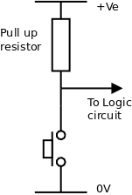
Pull-Up
When the push button is not pressed, the logic circuit is connected to positive through the resistor. The input to the logic circuit is Logic 1.
When the push button is pressed, the logic circuit is connected directly to 0 V. The input to the logic circuit is Logic 0.
Pull-up resistors are nominally 10 kΩ but can be any high value between 1 kΩ and 100 kΩ
Again, the resistor is necessary so that, when the button is pressed, the positive power supply is not simply connected to 0 V resulting in a short circuit.
The circuit is effectively a potential divider circuit where R2 is either 0 Ω or virtually infinite resistance.

Slide 12
Summary
In combinational logic circuits, the output depends only on the inputs
In sequential logic circuits, the output depends on the inputs and what the inputs were some time before
Analogue signals can take any value between a maximum and a minimum and can be negative as well as positive
Digital signals are either ON (logic 1) or OFF (logic 0)
The voltages representing logic 0 and logic 1 are usually 0 V and 5 V but can be any relatively low voltage and any relatively high voltage
Pull-up and pull-down resistors are necessary when push buttons are used as inputs

Slide 13
Questions
Give an example of a combinational logic circuit
Can a digital signal be negative?
What voltage represents logic 1?
What voltage represents logic 0?
What is a floating input?
What value should be used for a pull-up resistor?

Slide 14
Answers
Give an example of a combinational logic circuit
  Logic gates, Simple logic circuits, adders and multiplexers
Can a digital signal be negative? No
What voltage represents logic 1?
  Nominally 5 V, any voltage close to the positive power supply
What voltage represents logic 0?
  Nominally 0 V but any voltage close to the 0 V is acceptable
What is a floating input?
  An input that is not connected to anything
What value should be used for a pull-up resistor?
  1 kΩ to 100 kΩ, usually around 10 kΩ

