Slide 1
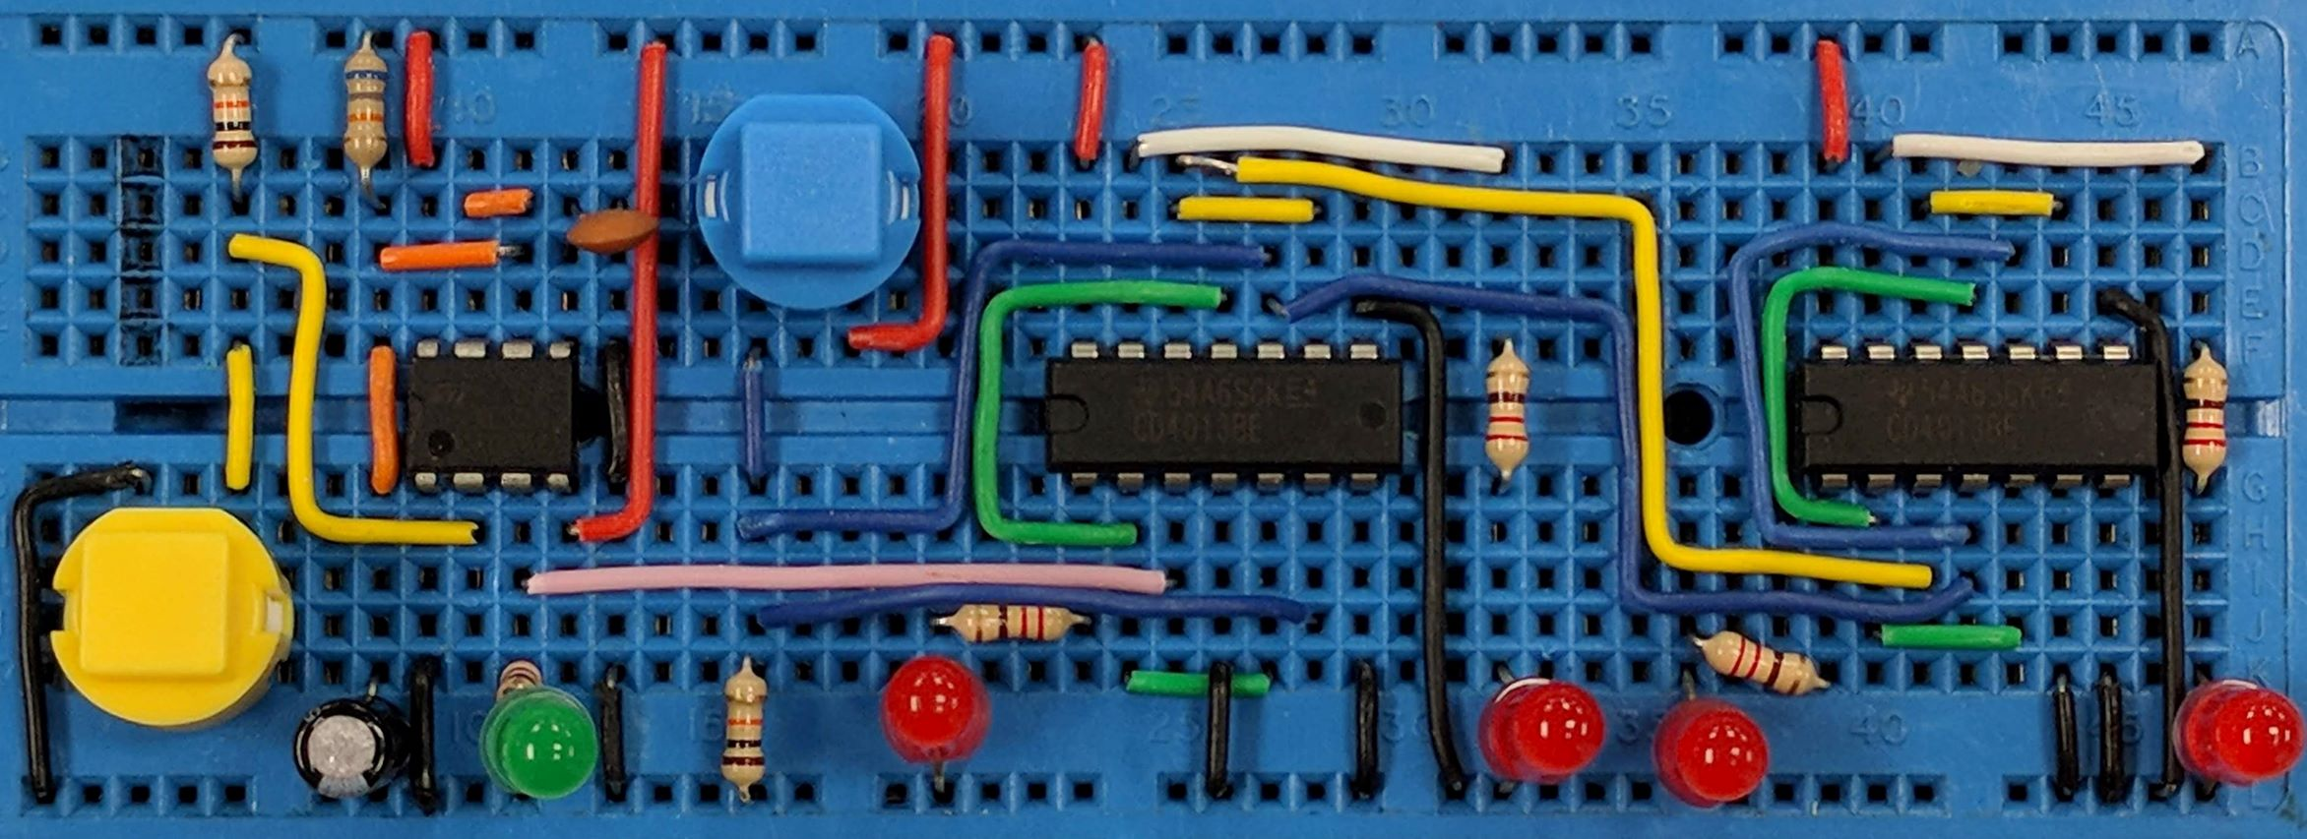
Power Supplies
AIM: To understand the simple power supply in terms of the transformer, rectification, smoothing and regulation.
PRIOR KNOWLEDGE: A.C. Theory including peak and R.M.S. voltages
www.pfnicholls.com

Slide 2

Overview
A power supply is used to provide a specific voltage of current for an electrical circuit
We usually think of a power supply being used to provide fixed LOW VOLTAGE D.C. from the A.C. mains.
BLOCK DIAGRAM
A transformer reduces the A.C. voltage to a safe level
The rectifier converts the A.C. into D.C.
Smoothing makes the D.C. from the rectifier more constant
The regulator produces a constant D.C. voltage

Slide 3
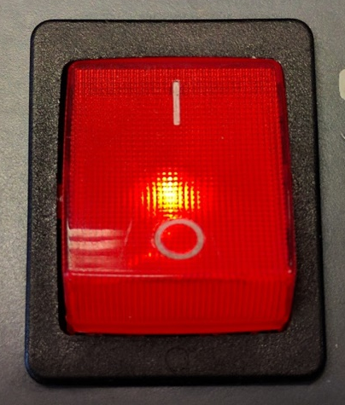
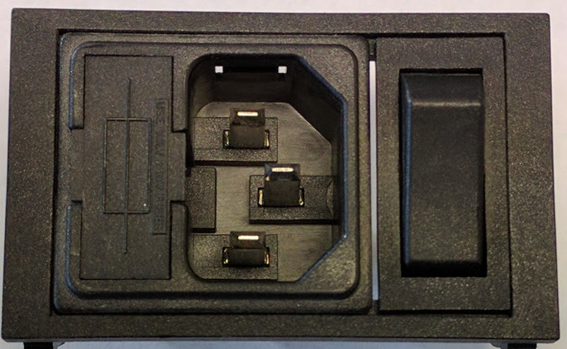
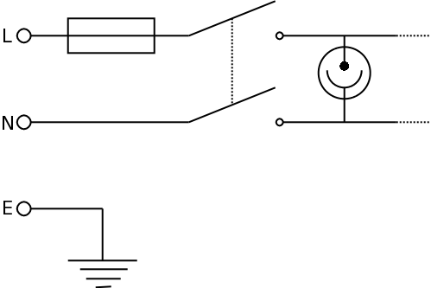
Input Circuit
The input circuit includes:
Power plug / mains connection
Mains switch
Fuse
Neon indicator
The Europlug socket shown has an integrated fuse (on the left) and single pole switch in the Live wire (on the right)
This double pole switch includes a built in Neon bulb to show when the mains power is connected. Both Live and Neutral are switched simultaneously.

Slide 4
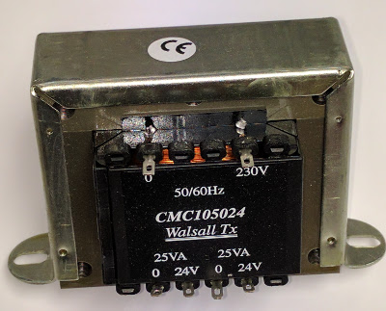
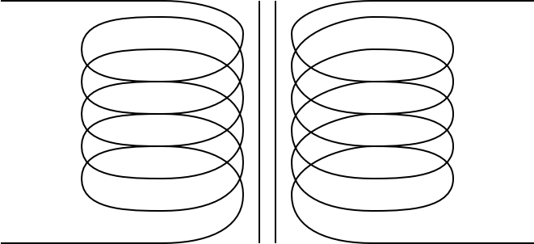
Transformer
A transformer is a pair of insulated coils of wire wound around a soft iron core
The primary coil is connected to the A.C. mains
The secondary coil produces a low voltage A.C. output
Primary
Secondary
The PRIMARY and SECONDARY coils are not electrically connected.
The A.C. Mains is not directly connected to the low voltage circuit.

Slide 5
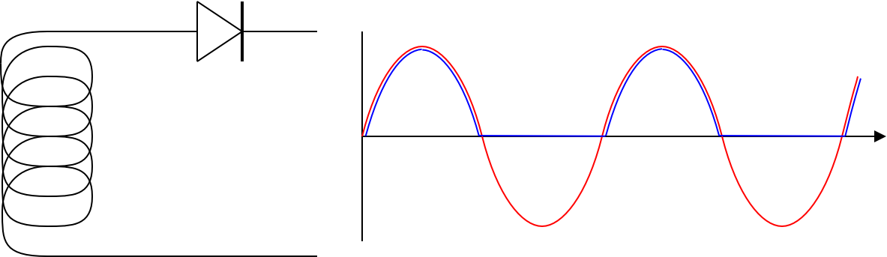
Half Wave Rectifier
A single Diode is connected to the secondary of the transformer.
The diode is only forward biased on the positive half of the A.C. cycle.
Only half of the A.C. is converted to D.C.
The Blue line is 0.7V less than the Red line
The RED line is the full A.C. output of the transformer
The BLUE line is half wave rectified. It is all positive and is therefore D.C.
D.C.
A.C.
Graph of Voltage (y-axis) against time (x-axis)

Slide 6
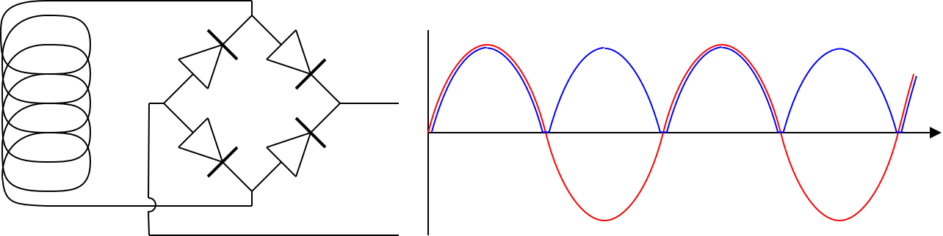
Full Wave Rectifier
A Full Wave (Bridge) Rectifier is made from four diodes.
On each half cycle of the A.C. two of the diodes conduct.
All of the A.C. is converted to D.C.
D.C.
The Blue line shows the rectified output which is only positive.
Because two diodes are used, the rectified output is 1.4 V less than the A.C.
A.C.
Graph of Voltage (y-axis) against time (x-axis)

Slide 7
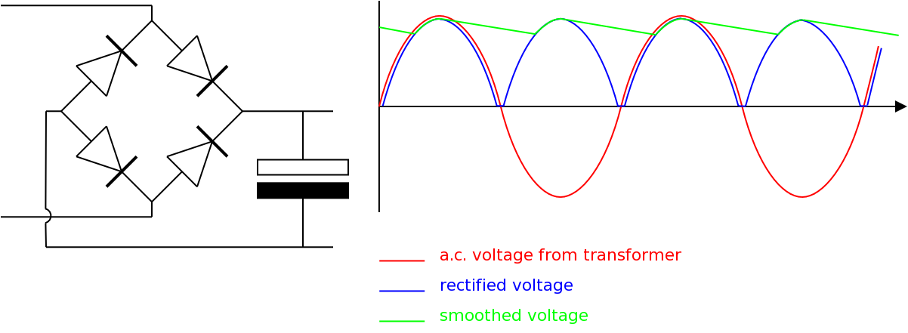
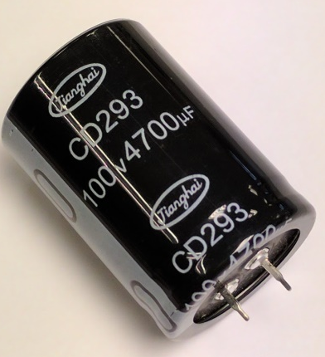
Smoothing
The output of the rectifier is D.C. but it is not constant.
A large value capacitor is used to stored charge when the D.C. falls to zero.
The capacitor keeps the voltage more or less constant.
The capacitor must have a working voltage greater than the peak voltage of the rectified A.C.
The Green line is the voltage on the capacitor, it is nearly constant
Capacitor is recharged here
Capacitor discharges slowly here

Slide 8
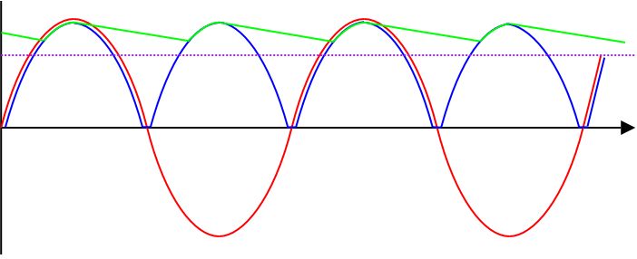
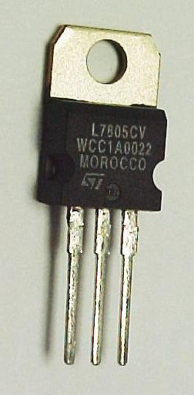
Voltage Regulator
Output fixed at this constant voltage
A simple 5V voltage regulator IC
The regulator makes the smoothed D.C. voltage into a fixed (lower) voltage as shown by the purple line on the diagram.
Voltage regulators are usually a simple 3 terminal device

Slide 9
Summary
The 230V mains is connected with the LIVE and NEUTRAL wires
The FUSE and SWITCH are both in the LIVE wire
The EARTH wire is connected to the metal case of the appliance
A NEON bulb is used to show the mains supply is ON
The TRANSFORMER reduces the 230V mains voltage to a lower safer voltage (this is a step down transformer)
The RECTIFIER coverts the A.C. from the transformer in to a rough D.C. which is always positive but varies a lot
A SMOOTHING CAPACITOR averages the rough D.C. making a more consistent voltage by storing and releasing charge
The REGULATOR produces a fixed steady output voltage

Slide 10
Questions
Where is the Earth wire connected?
Why is a Neon bulb used as a mains indicator?
Are there more turns on the primary or secondary of the transformer in a low voltage power supply?
What component is used to make a rectifier?
Should the smoothing capacitor be a large or small value?
What is the function of a regulator?
What colour are the mains wires in a plug?
What does DPST stand for?

Slide 11
Answers
To the metal case of the power supply or appliance
A Neon bulb is reliable, takes very little power and works directly at mains voltages (anything greater than 100V or so)
More on the primary of a step down transformer
Half wave rectifier: 1 diode. Full wave rectifier: 4 diodes
A large value, usually more than 1000μF
To provide a fixed output voltage
Live: Brown, Neutral: Blue, Earth: Yellow & Green
Double Pole Single Throw – a type of switch

