Slide 1
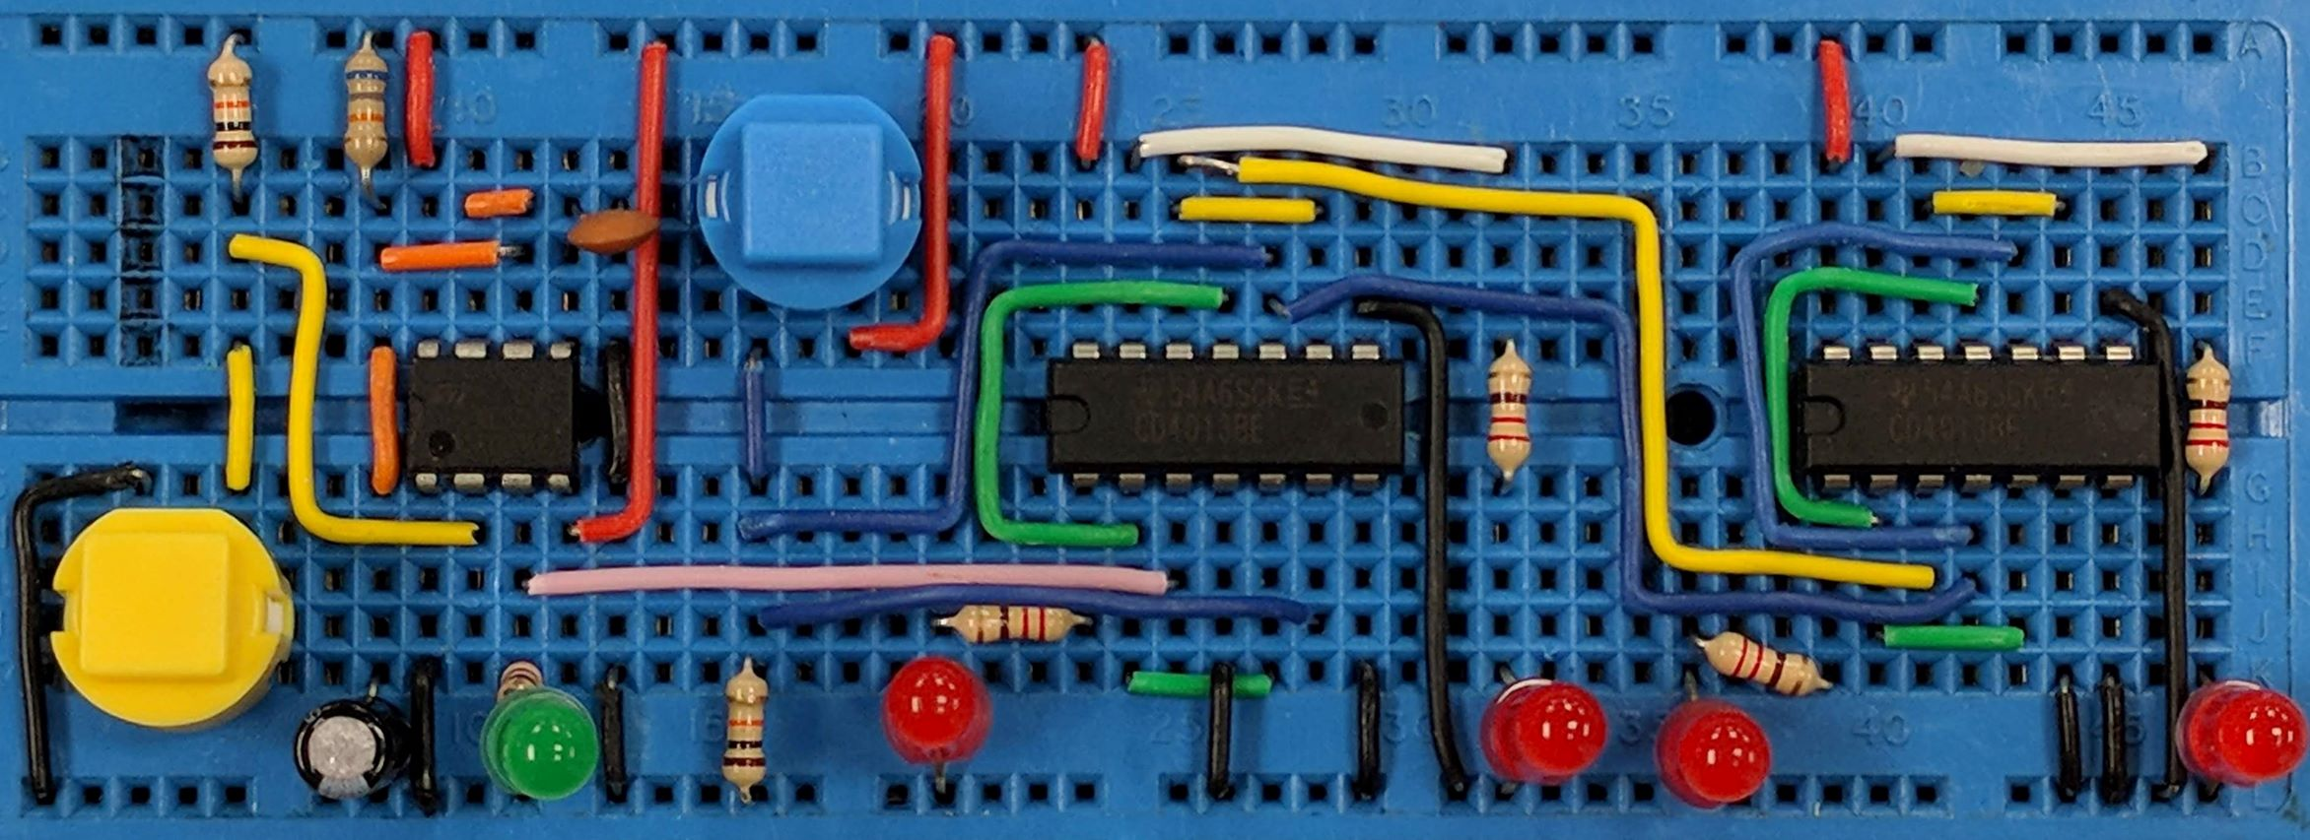
Radio
AIM:
To understand the parts of a simple A.M. radio and appreciate the purpose of modulation.
PRIOR KNOWLEDGE:
Frequency and Amplitude
www.pfnicholls.com

Slide 2
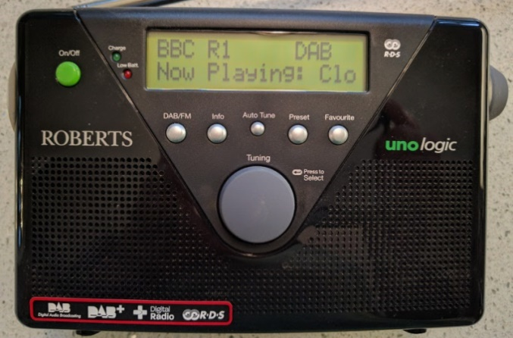
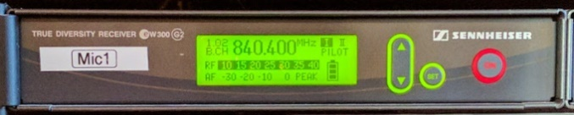
Overview
Information can be transmitted using radio waves. The radio waves travel at the speed of light and diffract around objects so that they can be received almost everywhere.
Different radio stations transmit radio waves at different frequencies. E.g. Radio 1 transmits at around 98MHz where as radio 2 transmits at around 89MHz.
DAB – Digital Radio Receiver
Radio Microphone Receiver
A simple radio receiver must (1) receive radio waves, (2) select just one frequency, (3) decode the information carried by the radio wave and (4) process the information to make it useful

Slide 3
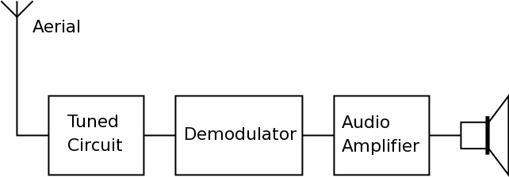
Block Diagram
NOTE: This is just the most basic “Simple Radio Receiver” and, in reality, modern radio receivers are much more complex. Receivers such as super heterodyne and DAB radios improve many aspects of performance
The output could equally be a display, a servo or a computer interface
The Aerial picks up all the available radio waves
The Tuned Circuit selects one frequency from all those received
The Demodulator extracts information carried by the radio wave
The Audio Amplifier and Speaker process the data

Slide 4
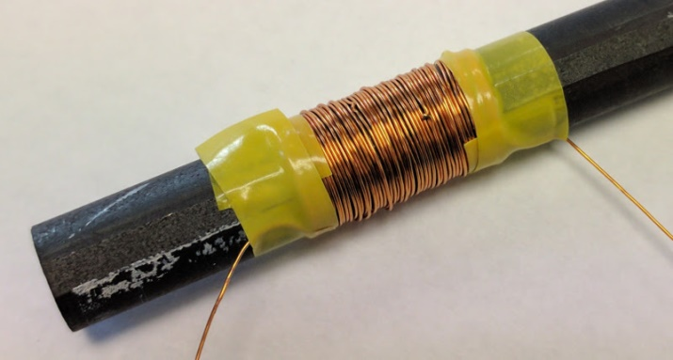
Aerial
The Aerial detects the electromagnetic radio waves. A radio wave is an oscillating electric and magnetic field. A radio wave has a particular frequency and amplitude.
Either the Electric or the Magnetic part of the radio wave induces a very small current in the aerial. It is this very small high frequency a.c. current that is detected by the tuned circuit.
An aerial is most effective when it is ¼ of the wavelength of the radio wave being detected.
This home made aerial is wound on a ferrite rod and picks up the magnetic component of the radio wave
The aerial symbol

Slide 5
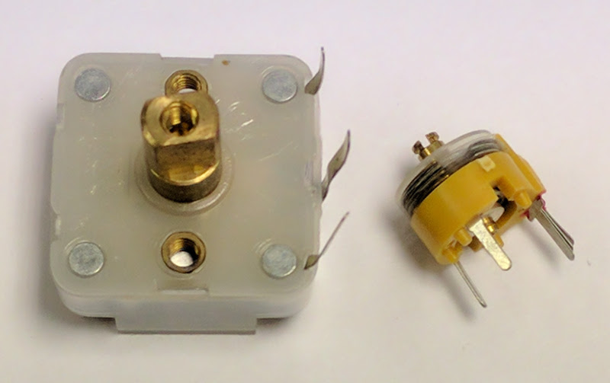
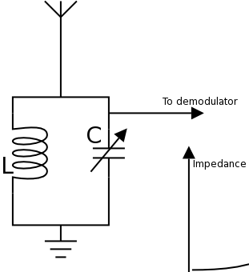
Tuned Circuit
The Tuned Circuit selects one particular frequency from all those frequencies picked up by the Aerial.
The tuned circuit uses a Capacitor (C) and an Inductor (L) to create a circuit that responds differently to different frequencies. By adjusting the value of the Capacitor or Inductor the response of the tuned circuit can be changed.
It is more common to vary the Capacitor in the tuned circuit.
Variable Capacitors
Variable Capacitor

Slide 6
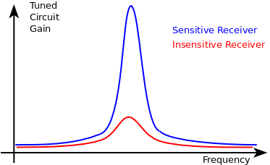
Sensitivity
The Sensitivity of a radio receiver is a measure of how well it can detect weak signals and distinguish these from the background noise.
The blue line represents a sensitive receiver because, at the selected carrier frequency, the output is much larger than the background noise.

Slide 7
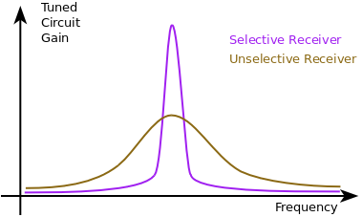
Selectivity
The selectivity of a radio receiver is a measure of how well the tuned circuit can distinguish between two radio signals with very similar frequencies.
The purple line represents a selective radio receiver. The peak is narrow and only a very small range of frequencies are passed from the tuned circuit to the demodulator.

Slide 8
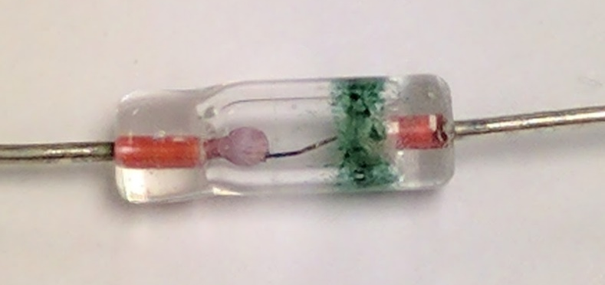
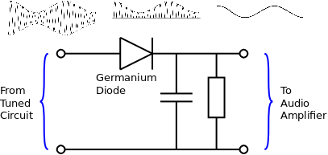
Demodulator
The demodulator separates the transmitted information / data from the carrier wave and discards the carrier wave.
The Diode half wave rectifies the signal from the tuned circuit.
The capacitor smooths the rectified signal to give the original audio signal

Slide 9
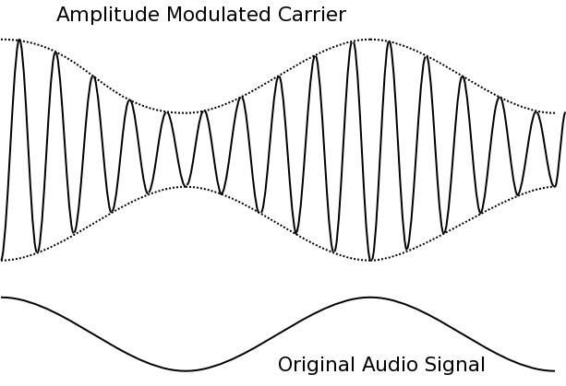
Amplitude Modulation (A.M.)
The amplitude of the Carrier Wave varies as the amplitude Audio Signal varies.
The frequency of the transmitted signal stays constant.
You need to be able to draw and interpret a diagram of A.M.

Slide 10
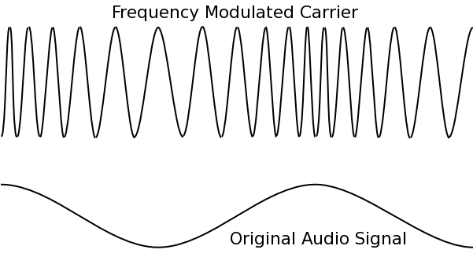
Frequency Modulation (F.M.)
The frequency of the Carrier Wave varies as the amplitude of the Audio Signal varies
The amplitude of the carrier wave does not change.
When the Amplitude of the audio signal is LOW, the carrier has a LOW frequency
When the Amplitude of the audio signal is HIGH, the carrier has a HIGH frequency

Slide 11
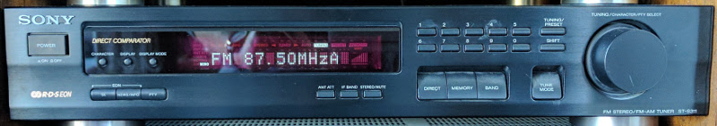
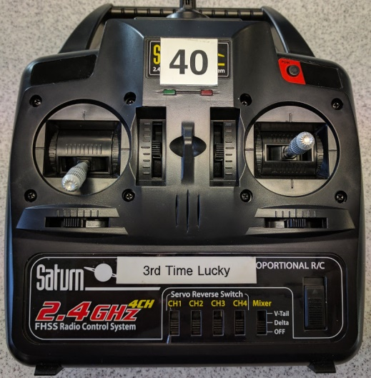
Audio Amplifier & Speaker
A HiFi radio receiver outputs to a HiFi system
The output of a simple radio maybe an audio amplifier (for just the low frequency audio signal) and a loudspeaker, headphones or an output to a HiFi unit.
Other types of radio might have an output that controls servos or connects to a computer.
The receiver for a radio control system is similar to a domestic receiver.
However, the demodulator’s output is used to drive servos

Slide 12
A.M. versus F.M.
Amplitude Modulation (A.M.) | Frequency Modulation (F.M.)
Poor: Very prone to interference (from electrical appliances etc) | Good: Very little interference from environment
Good: Can be a very simple receiver circuit needing only a few components | Good: Can receive high quality stereo audio signals (e.g. radio 1)
Good: Easy to modulate and demodulate. | Poor: Range can be limited to line of sight of transmitter
Poor: Tends to use low frequency/long wavelength carrier resulting in low quality audio signal (often in mono) | Note: F.M. tends to use a high frequency carrier and therefore can carry more data / better quality audio. However, the short wavelength of the carrier limits diffraction and so radio shadows can occur behind hills etc.
Good: Long wavelength carrier has good range and diffracts around landscape for better reception.

Slide 13
Summary
The aerial receives radio waves of all frequencies and generates a very small high frequency alternating electrical current
The frequency of a particular radio signal is fixed and is called the carrier frequency
The tuned circuit selects one carrier frequency from all those received by the aerial
The demodulator extracts the data / audio signal from the carrier wave (and discards the carrier wave)
The audio frequency amplifier and loudspeaker process the demodulated signal to produce sound
The modulation can be either A.M. or F.M.
Amplitude Modulation (A.M.) is prone to interference and low quality
Frequency Modulation (F.M.) is not easily affected by interference and is of a high quality

Slide 14
Questions
What do A.M. and F.M. stand for?
What is the purpose of the aerial?
What is the purpose of the tuned circuit?
What is the purpose of the demodulator?
What is meant by sensitivity?
What is meant by selectivity?
What is the main disadvantage of A.M.?
Is A.M. or F.M. used for high quality broadcasts?

Slide 15
Answers
Amplitude Modulation and Frequency Modulation
The aerial converts the electromagnetic radio waves into small a.c. electrical signals
The tuned circuit selects one carrier frequency from all those detected by the aerial
The demodulator separates the audio signal from the carrier
Sensitivity is a measure of how well a radio receiver detects a weak radio signal against the background noise.
Selectivity is how well a radio receiver can distinguish two carrier waves with very similar frequencies
A.M. is very prone to interference from the environment
F.M. … it is much better

