Slide 1
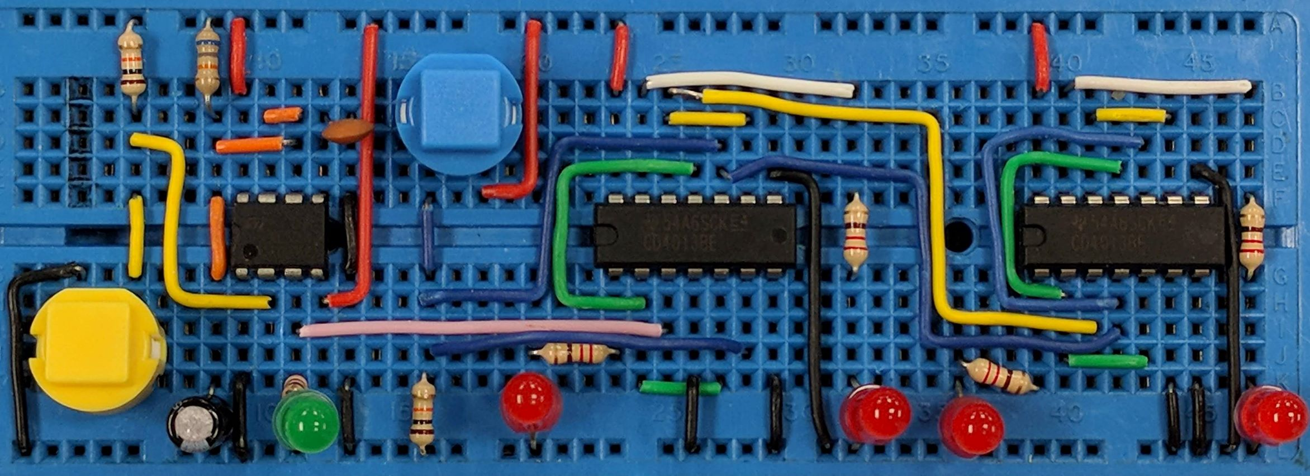
Resistors
AIM:
To know the characteristics of different types of resistors
PRIOR KNOWLEDGE:
Understand resistance
www.pfnicholls.com

Slide 2
Properties of Resistors
A resistor is a component that opposes the flow of current.
A resistor is a passive component, it does not require a power supply to operate, the resistance is a property of the material that the resistor is made from.
When current flows through a resistor, it dissipates energy and gets hot - this may or may not be useful! All resistors have a maximum power rating which, if exceeded, results in damage.
Resistance is measured in ohms (Ω)and all resistors have a tolerance that indicates how close they actually are to the stated value of resistance

Slide 3
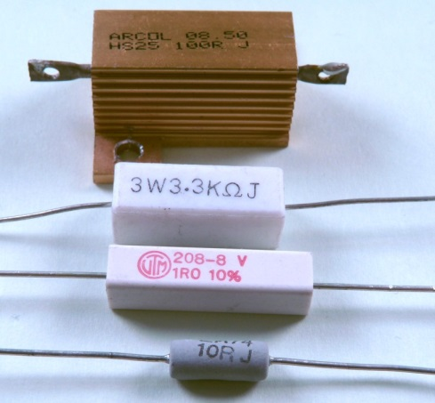
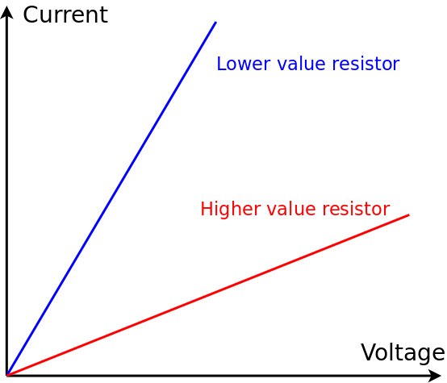
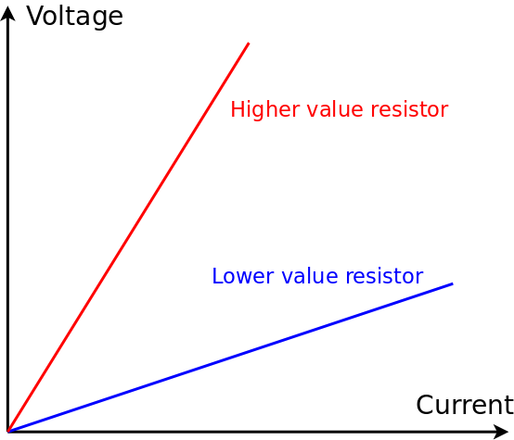

Fixed Resistors
A fixed resistor is, as the name suggests, a fixed predetermined value. Lower power resistors are either made from carbon film or metal film. Power resistors can be either ceramic or wire wound.
Fixed resistors obey Ohm’s Law which states that the Potential Difference and Current are directly proportional at a constant temperature.

Slide 4
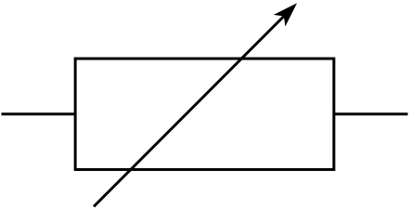
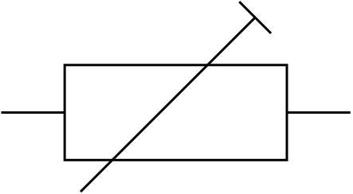
Variable Resistors
A variable resistor is, as the name suggests, able to have a range of resistances between zero and some stated maximum resistance.
Therefore a 10kΩ variable resistor can have any value between 0Ω and 10kΩ as determined by the user.
Variable resistors are used to control the current in a circuit, an example might be dimming a bulb or slowing a motor.

Slide 5
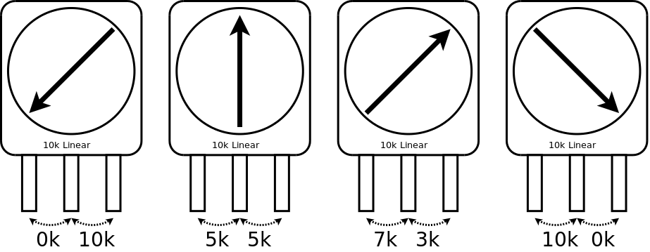
Potentiometers
A potentiometer is a much more useful form of variable resistor. In fact a variable resistor is, in reality, a potentiometer with one of the connections remaining unused.
A potentiometer has 3 connections. The resistance between the two outer connections is a fixed value. The resistances between the centre connection and each of the two outer connections is variable – but the two always add up to the same total resistance.
The resistance between the outer most terminals is always 10kΩ
The resistance between the centre terminal and the outer terminals always adds up to 10kΩ

Slide 6
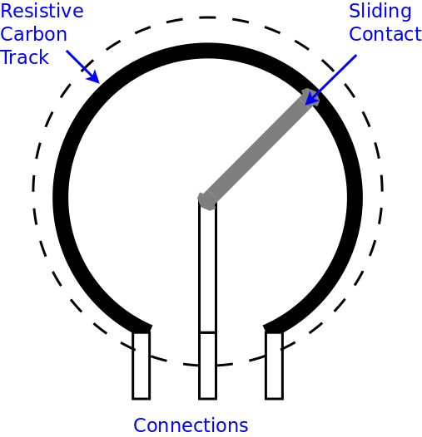
Potentiometers
Inside a potentiometer a sliding contact moves along a carbon track (or a wire wound track) – the resistance of the track remains fixed but the resistance between the end and the sliding contact changes
The carbon track is effectively a fixed value resistor and the sliding contact connects to a section of the carbon track. A potentiometer is effectively two resistors in series – as the value of one resistor increases, the other decreases to that their total remains constant.

Slide 7
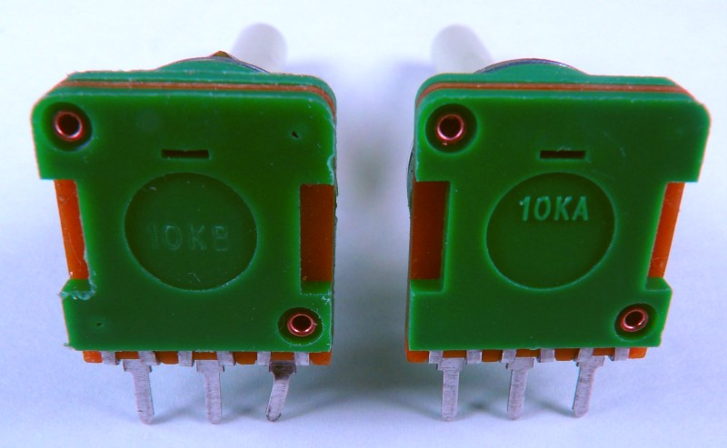
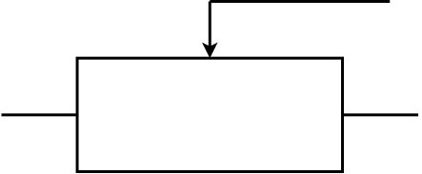
Potentiometers
The resistance of a rotary or linear potentiometer can either change linearly with position or logarithmically with position.
In the case of the logarithmic potentiometer (“log pot” for short), a small change in position results in a small change in resistance at one end of the track but the same small change of position results in a large change in resistance at the other end of the track.
A Linear potentiometer is marked with a B
A Logarithmic potentiometer is marked with an A

Slide 8
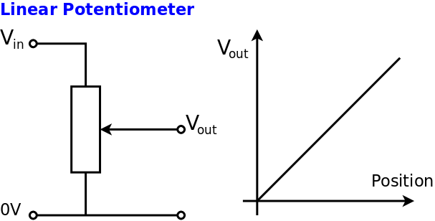
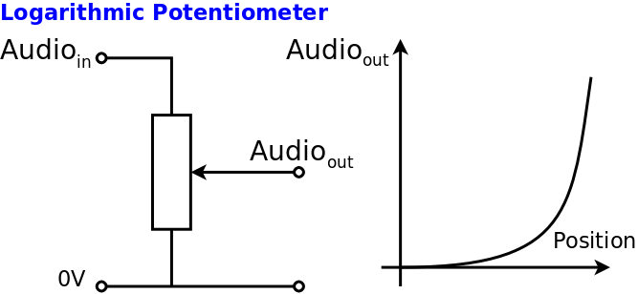
Potentiometers
The function of a potentiometer is to act as a potential divider. A potential difference is applied across the outer most connections. The inner connection is a fraction of the applied potential difference.
This is useful in voltage supplies (Lin) and volume controls (Log)

Slide 9
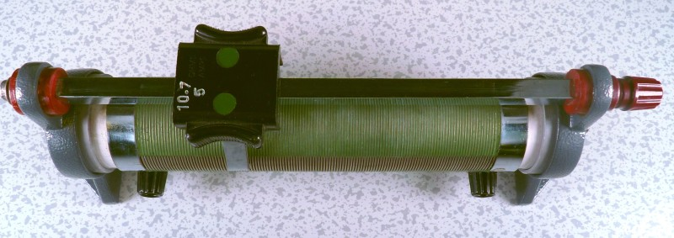
Rheostats
A rheostat is a potentiometer that can handle large currents. Therefore, a rheostat is a power version of a potentiometer.
Rheostats are often used to limit current and are most often configured as a simple variable resistor.

Slide 10
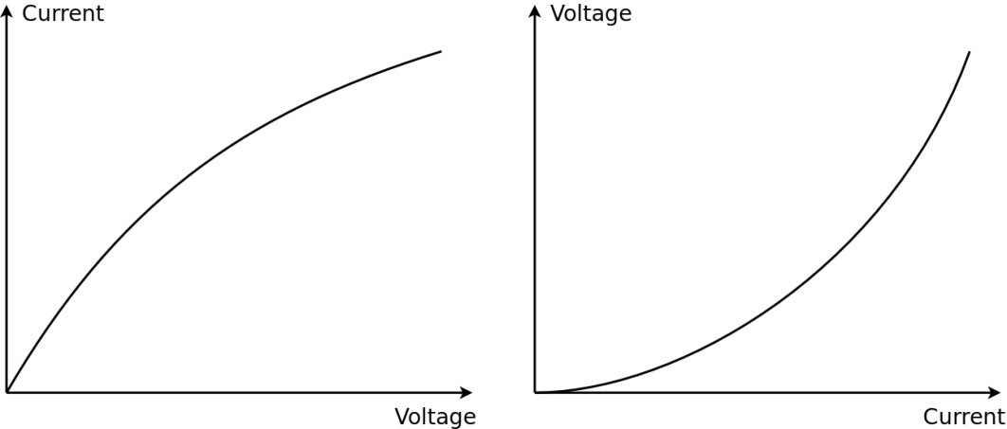
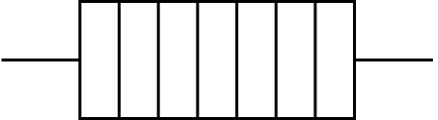
Wire, Heater, Filament
Resistance wire is a material such as constantan or nichrome, that has a high resistance compared to normal conductors such as copper and aluminium.
Because a length of resistance wire has significant resistance, it will dissipate energy – i.e. it will get hot – this is useful for heating elements in devices such as toasters.
The Resistance of a wire increases as it gets hot

Slide 11
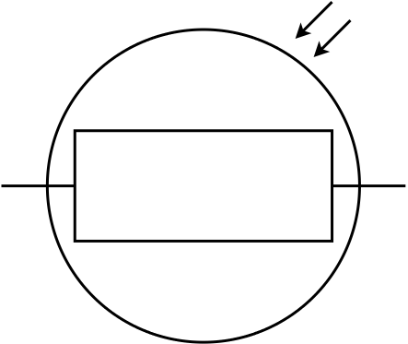
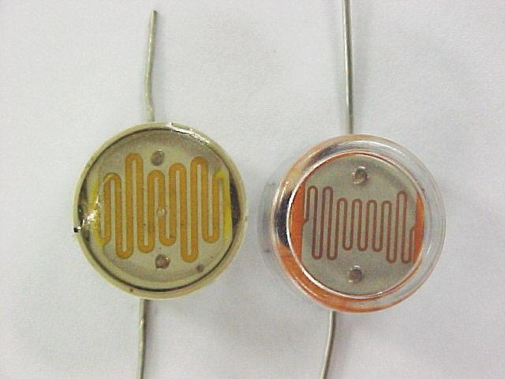
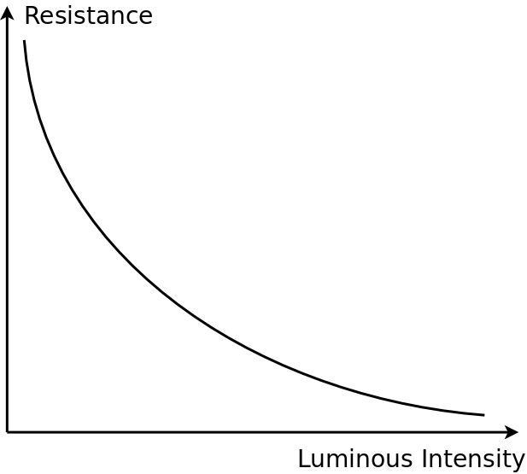
Light Dependant Resistor (LDR)
A Light Dependent Resistor (LDR) is a semiconductor device.
The resistance of the semiconductor reduces when energy is supplied. Therefore, the design of an LDR is such that the resistance of the LDR reduces as the light level increases.

Slide 12
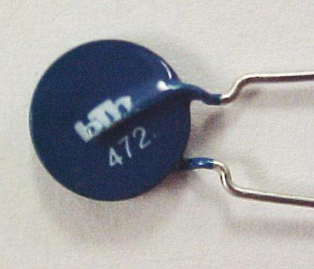
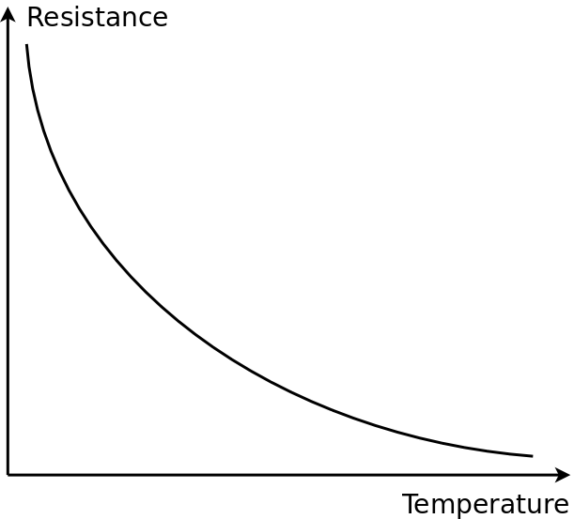
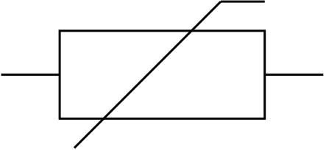
NTC Thermistor
An NTC thermistor, is another semiconductor device. The resistance of the semiconductor reduces when thermal energy is supplied. Therefore, the resistance of the thermistor reduces as the temperature increases. This is the “usual” type of thermistor used in electronics. NTC means Negative Temperature Coefficient.

Slide 13
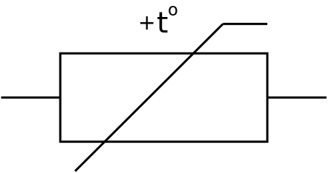
PTC Thermistor
A PTC thermistor behaves in the opposite manner to a regular NTC thermistor. In the case of a PTC thermistor, the resistance of the thermistor increases as the temperature increases. These are the more unusual type of thermistor.
PTC means Positive Temperature Coefficient
The Resistance-Temperature graph for a PTC Thermistor is more complex than for an NTC Thermistor. The resistance rises sharply at a certain threshold temperature.

Slide 14
Summary
The resistance of a component depends on its physical construction and may, or may not, be a constant value.
Resistance is measured in Ohms (Ω)
Resistance is defined as: Resistance = Voltage / Current
The resistor equation is: R = V / I
Variable resistors and potentiometers are components where the resistance can be altered mechanically, by moving something.
The resistance of an LDR decreases as light level increases
The resistance of an NTC thermistor decreases as temperature increases.

Slide 15
Questions
What is the difference between a variable resistor and a potentiometer?
What is the difference between an NTC and a PTC thermistor?
What type of thermistor would you normally expect to use?

Slide 16
Answers
A variable resistor is a two terminal device. The resistance between the terminals can be changed. A potentiometer is a three terminal device. The resistance between the two end terminals is fixed. The resistance between the either end and the centre terminal can be changed.
NTC: resistance increases as temperature decreases
PTC: resistance increases as temperature increases
NTC type thermistors are more commonly used (in schools)

