Slide 1
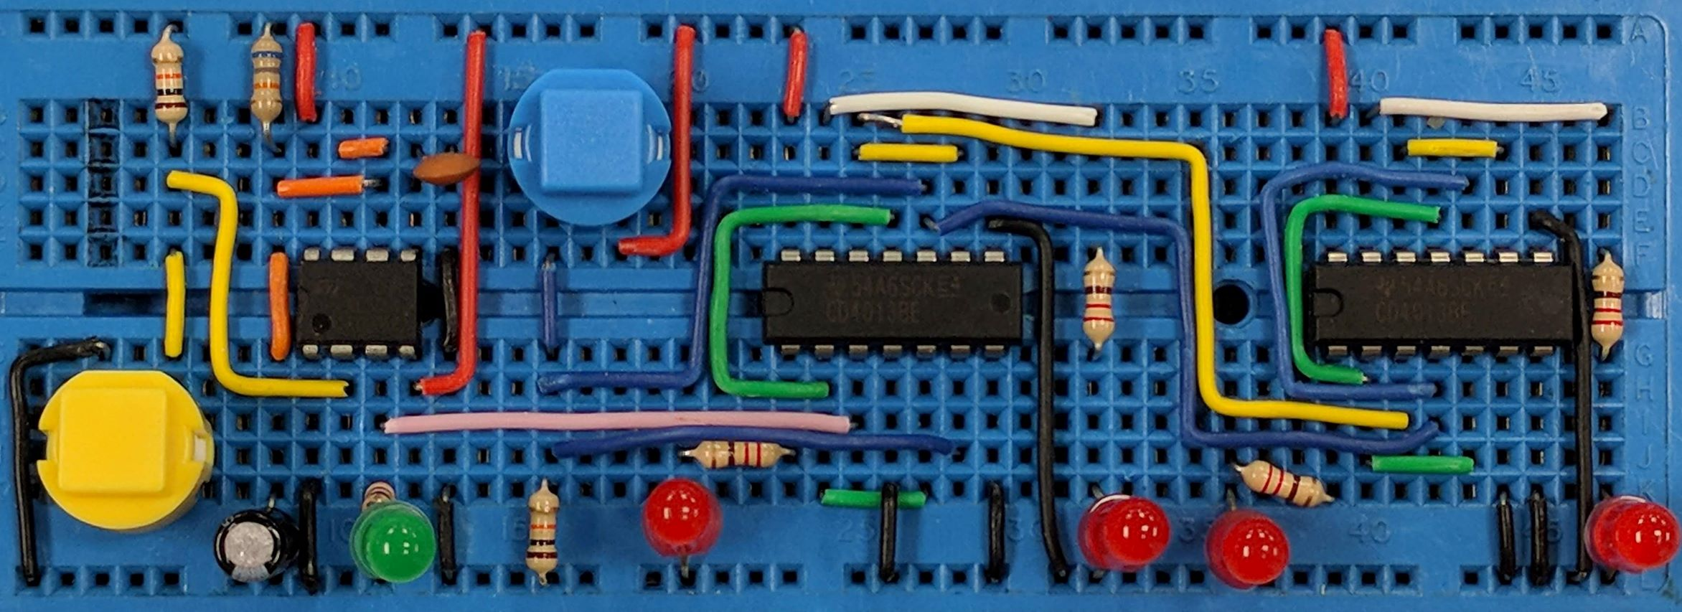
Resistors in Series & Parallel
AIM: To be able to use the equations for resistors in series and resistors in parallel
PRIOR KNOWLEDGE: Resistance and resistors, voltage and current laws in circuits
www.pfnicholls.com

Slide 2
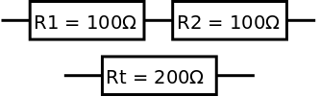
Resistors in Series
Two resistors connected in series have a combined effect equivalent to a single resistor of a higher value
The two 100 Ω resistors connected in series are completely equivalent to the single 200 Ω resistor
The 200 Ω can be replaced by a pair of 100 Ω resistors or the two 100 Ω resistors can be replaced by a single 200 Ω resistor
The total overall resistance of the combination is given by the equation
Rt = R1 + R2

Slide 3
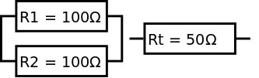
Resistors in Parallel
Two resistors connected in parallel have a combined effect equivalent to a single lower value resistor
The total overall resistance of the parallel combination is given by the equation
1/Rt = 1/R1 + 1/R2
or
Rt = (R1 x R2) / (R1 + R2)
The 50 Ω resistor can be replaced by a pair of 100 Ω resistors in parallel or a pair of 100 Ω resistors can be replaced by a single 50 Ω resistor
It may seem counter intuitive that the total resistance is less but, for a pair of parallel resistors, more current flows in total so the total resistance is lower

Slide 4
More than two resistors
For three of more resistors in series, the equation becomes
Rt = R1 + R2 + R3 + ….
For three or more resistors in parallel the equation becomes
1/Rt = 1/R1 + 1/R2 + 1/R3 + …..
The equation
Rt = (R1 x R2) / (R1 + R2)
is a special case for two resistors in parallel

Slide 5
General Considerations
When combining resistors remember: ….
For two or more resistors in series, the total resistance is always greater than the largest individual resistor … resistance goes up
For two or more resistors in parallel, the total resistance is always less than the smallest individual resistor … resistance goes down
Calculated resistor values should only be given to 2 significant figures. The resistors generally have a ± 5% tolerance so any precision greater than 2 significant figures is irrelevant
Always use resistors from the E24 series … other values are not available!

Slide 6

Example 1
What is the total resistance? Try to do the problem before clicking to see the solution
The resistors are in Series
Rt = R1 + R2
Rt = 120 + 68
Rt = 188 Ω
Resistors are usually given to two significant figures
Rt = 190 Ω

Slide 7

Example 2
What is the total resistance? Try to do the problem before clicking to see the solution
The resistors are in Series
Rt = R1 + R2
Rt = 1400 + 330 Remember 1k4 = 1400
Rt = 1730 Ω
Resistors are usually given to two significant figures
Rt = 1800 Ω

Slide 8
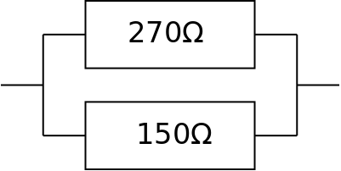
Example 3
What is the total resistance?
Try to do the problem before clicking to see the solution
The resistors are in Parallel therefore 1/Rt = 1/R1 + 1/R2
1/Rt = (1/270) + (1/150) = 0.0104 This is NOT the answer
1/Rt = 0.0104 → Rt = 1/0.0104
Rt = 96.4 Ω
Resistors are usually given to two significant figures
Rt = 96 Ω

Slide 9
Example 4
What is the total resistance? Try to do the problem before clicking to see the solution
The resistors are in Series
Rt = R1 + R2
Rt = 120 + 68
Rt = 188 Ω
Resistors are usually given to two significant figures
Rt = 190 Ω

Slide 10
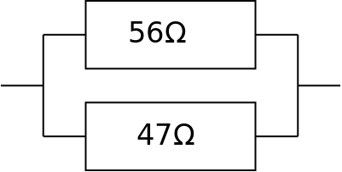
Example 4
What is the total resistance?
Try to do the problem before clicking to see the solution
The resistors are in Parallel and so 1/Rt = 1/R1 + 1/R2
1/Rt = (1/56) + (1/47) = 0.039
Rt = 1/0.039
Rt = 25.6 Ω
Resistors are usually given to two significant figures
Rt = 26 Ω

Slide 11
Example 4 again
What is the total resistance?
This time, use Rt = (R1 x R2) / (R1 + R2)
Try to do the problem before clicking to see the solution
The resistors are in Parallel, now try Rt = (R1 x R2) / (R1 + R2)
Rt = (56 x 47) / (56 + 47)
Rt = 2632 / 103 = 25.6 Ω
Rt = 26 Ω
This method looks more straight forward but only applies to two resistors in parallel

Slide 12
Example 5
What is the total resistance? Try to do the problem before clicking to see the solution
The resistors are in Series
Rt = R1 + R2 + R3
Rt = 10 + 12 + 15
Rt = 37 Ω

Slide 13
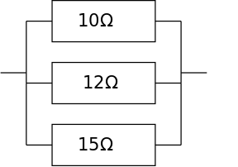
Example 6
What is the total resistance?
Try to do the problem before clicking to see the solution
The resistors are in Parallel
1/Rt = 1/R1 + 1/R2 + 1/R3
1/Rt = 1/10 + 1/12 + 1/15 = 0.25
Rt = 1/0.25 = 4
Rt = 4 Ω

Slide 14

Example 7
What resistor is used to make the total resistance 150 Ω?
Try to do the problem before clicking to see the solution
The resistors are in Series
Rt = R1 + R2 → R2 = Rt – R1
R2 = 150 – 91 = 59 Ω
The E24 series is:
10, 11, 12, 13, 15, 16, 18, 20, 22, 24, 27, 30, 33, 36, 39, 43, 47, 51, 56, 62, 68, 75, 82, 91
Therefore use R2 = 56 Ω or 62 Ω

Slide 15
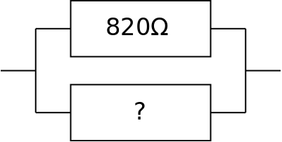
Example 8
What resistor is used to make the total resistance 530 Ω?
Try to do the problem before clicking to see the solution
The resistors are in Parallel
1/Rt = 1/R1 + 1/R2
1/R2 = 1/Rt – 1/R1
1/R2 = (1/530) – (1/820) = 0.00067
R2 = 1/0.00067 = 1499 Ω
The E24 series is:
10, 11, 12, 13, 15, 16, 18, 20, 22, 24, 27, 30, 33, 36, 39, 43, 47, 51, 56, 62, 68, 75, 82, 91
Therefore use R2 = 1500 Ω or 1k5 Ω

Slide 16
Summary
For resistors in series, Rt = R1 + R2
For resistors in series, the total resistance is always bigger than either R1 or R2
For resistors in parallel, 1/Rt = 1/R1 + 1/R2
Rt = (R1 x R2) / (R1 + R2) can be used for two parallel resistors
For resistors in parallel, the total resistance is always smaller than either R1 or R2
Resistance values should only be given to 2 significant figures (because resistors have ± 5% tolerance)
Resistors should be chosen from the E24 series

Slide 17
Questions
E24: 10, 11, 12, 13, 15, 16, 18, 20, 22, 24, 27, 30, 33, 36, 39, 43, 47, 51, 56, 62, 68, 75, 82, 91
What is Rt for 12 kΩ and 18 kΩ in series?
For 39 kΩ and 1k5 Ω in series, Rt = ?
Given R1 = 47 kΩ and R2 = 100 Ω, what is Rt?
13 Ω, 24 Ω and 91 Ω in series give Rt = ?
For 20 Ω and 30 Ω in parallel, what is Rt?
What is the total resistance of 3x 330 Ω resistors in parallel?
What resistor is added in series with a 560 Ω resistor to give a total resistance of 1 kΩ
What resistor is added in parallel with a 270 Ω resistor to give a total resistance of 140 Ω?

Slide 18
Answers
E24: 10, 11, 12, 13, 15, 16, 18, 20, 22, 24, 27, 30, 33, 36, 39, 43, 47, 51, 56, 62, 68, 75, 82, 91
What is Rt for 12 kΩ and 18 kΩ in series? Rt = 30 kΩ
For 39 kΩ and 1k8 Ω in series, Rt = ? Rt = 41 kΩ
Given R1 = 47 kΩ and R2 = 100 Ω, what is Rt? Rt = 47 kΩ
13 Ω, 24 Ω and 91 Ω in series give Rt = ? Rt = 130 Ω
For 20 Ω and 30 Ω in parallel, what is Rt? Rt = 12 Ω
What is Rt for three 330 Ω resistors in parallel? Rt = 110 Ω
What resistor is added in series with a 560 Ω resistor to give a total resistance of 1 kΩ R2 = 430 Ω
What resistor is added in parallel with a 270 Ω resistor to give a total resistance of 140 Ω? Rt = 300 Ω
All answers to 2 significant figures and from E24 series

